Slide 1
Introduction to
5S/Kaizen/TQM

Slide 2
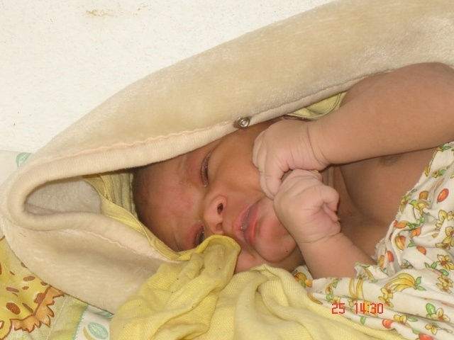
This is the future generation and nation builder
We need to protect them with good quality preventive, curative and promotive medical care services

Slide 3
Inaccurate test results
Test result is lost
Long waiting for consultation
Doctor cannot be contacted for emergencies
Hospital acquired infection
Wrong administration of drug/infusion
Failing supply system
disorganized hospital….

Slide 4

Many Hospitals do not look at patients as human being
Dignity
Basic human needs
Prompt attention in care and treatment
Confidentiality
Communication
Health service is not focused on customers’ expectations, and
Service is not attractively presented to people
Medical technology saves lives, Management is also helpful in saving lives

Slide 5
Back yard service function
Kitchen, Linen, Warehouse, Water supply, Electricity, Pharmaceutical storage, Clinical record storage, etc……
Central services and logistics
Laboratories, Imaging Diag. services, Blood bank, Health INFO, ICU, Op Theatre system, Pharmacy, Hosp. Adm. Section etc….
Front-line Services: Diagnosis, Treatments, Follow-up, Individual health promotion
OPD, Wards, Emergency, Rehabilitation, Social Work, Health education service etc…………………………………..

Slide 6
Weakness in the backyard and central services causes weakness in the frontline services
This results in low staff satisfaction as well as low client satisfaction
One of the ways to improve staff satisfaction is to improve the work environment, through application of 5S

Slide 7
5S: Definitions
Sort:
Identify and remove unnecessary and unused items from the workplace & reduce clutter
Set:
Arrange necessary items in order to reduce time for searching and retrieving and for easy operation
Shine:
Keep the workplace clean so that there is no dust on floor, machines or equipment (maintain daily cleaning schedule)
Standardize:
Set up the above 3Ss as norms in all the places
Sustain:
Training people to follow good work habits and strict observation of workplace rules

Slide 8
Sort
Unwanted item store
Use of red tag to identify the unwanted items, all the items should be labeled with explanation of problems
From indoor to outdoor, no area should be spared
Segregation of solid waste and introduction of the concept of reducing and reusing of waste
Organize big sorting day once in a month

Slide 9
Sort
<Classification of items and actions against them>
Always Necessary
Keep in the venue and make as an object of “Set”
Keep in the storage and make it available to use when necessary
Occasionally Used
Unnecessary
Keep in the store and discard after permission has been granted

Slide 10
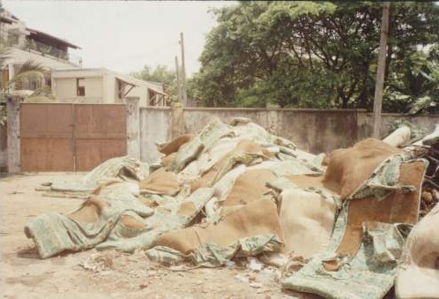
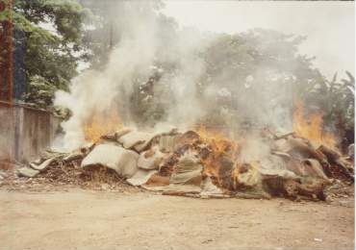
Sort
Discarding unnecessary items

Slide 11
Set
Target and prioritize places for easy application
Use 5S tools to set the work stations, such as color coding, X-axis Y-axis principles, etc.
Label the rooms based on their functions
Place name tag and board (e.g., direction board)
Set the inventory system with tagging and labeling the equipment and other items, including fixation of their location

Slide 12
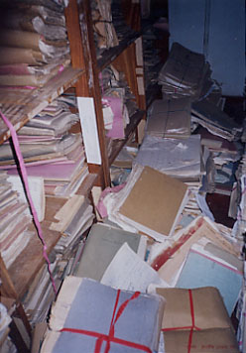
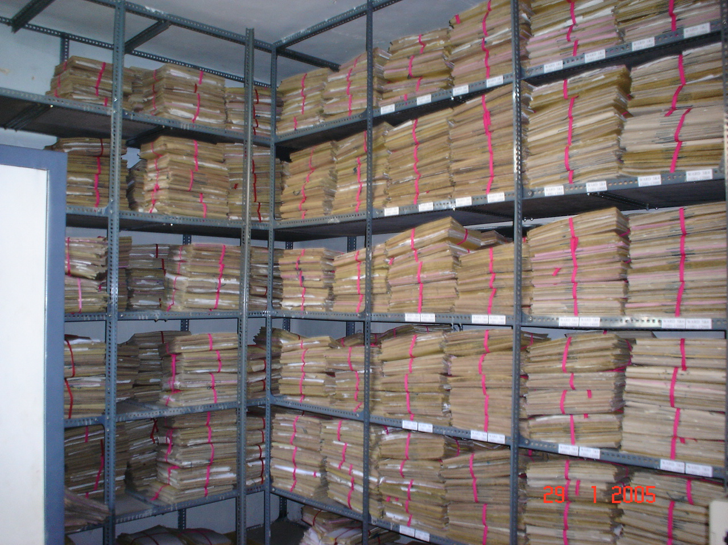
Set
Before
Documents orderly kept for work
efficiency
After

Slide 13
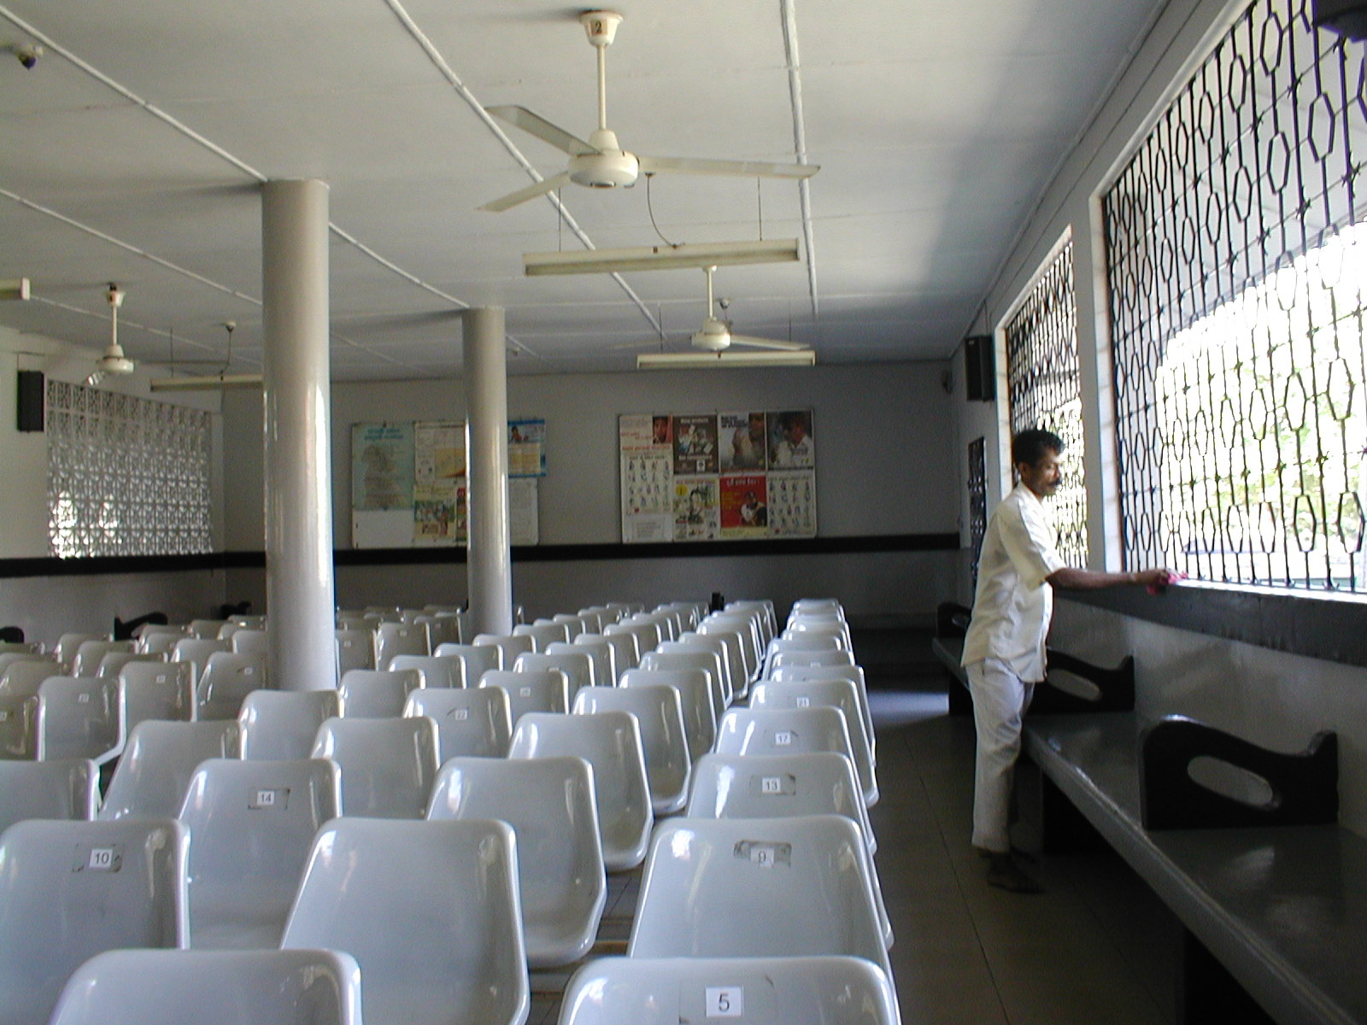
Set
Alignment of chairs with numbering for customer's comfort

Slide 14
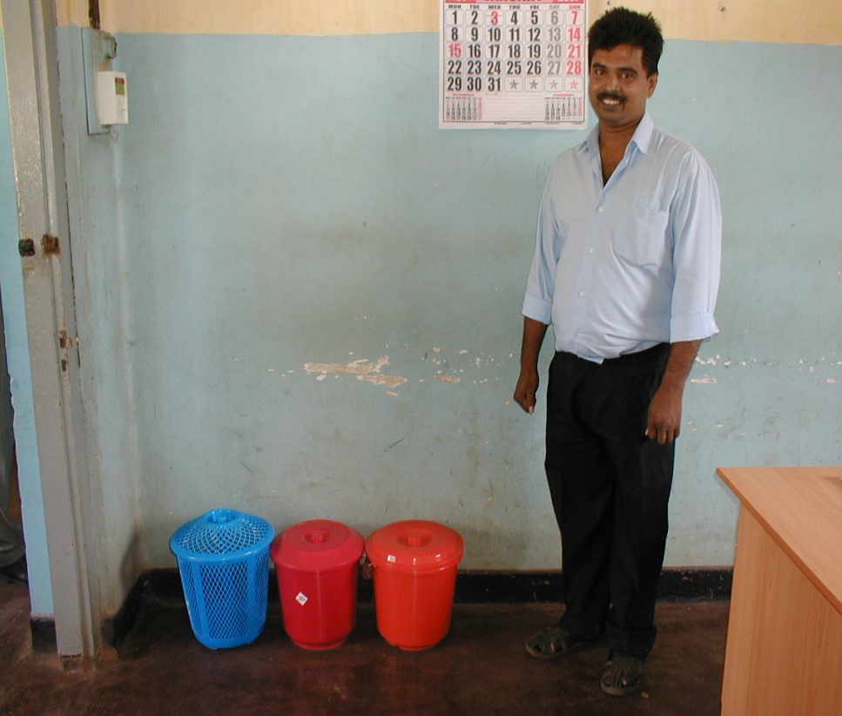
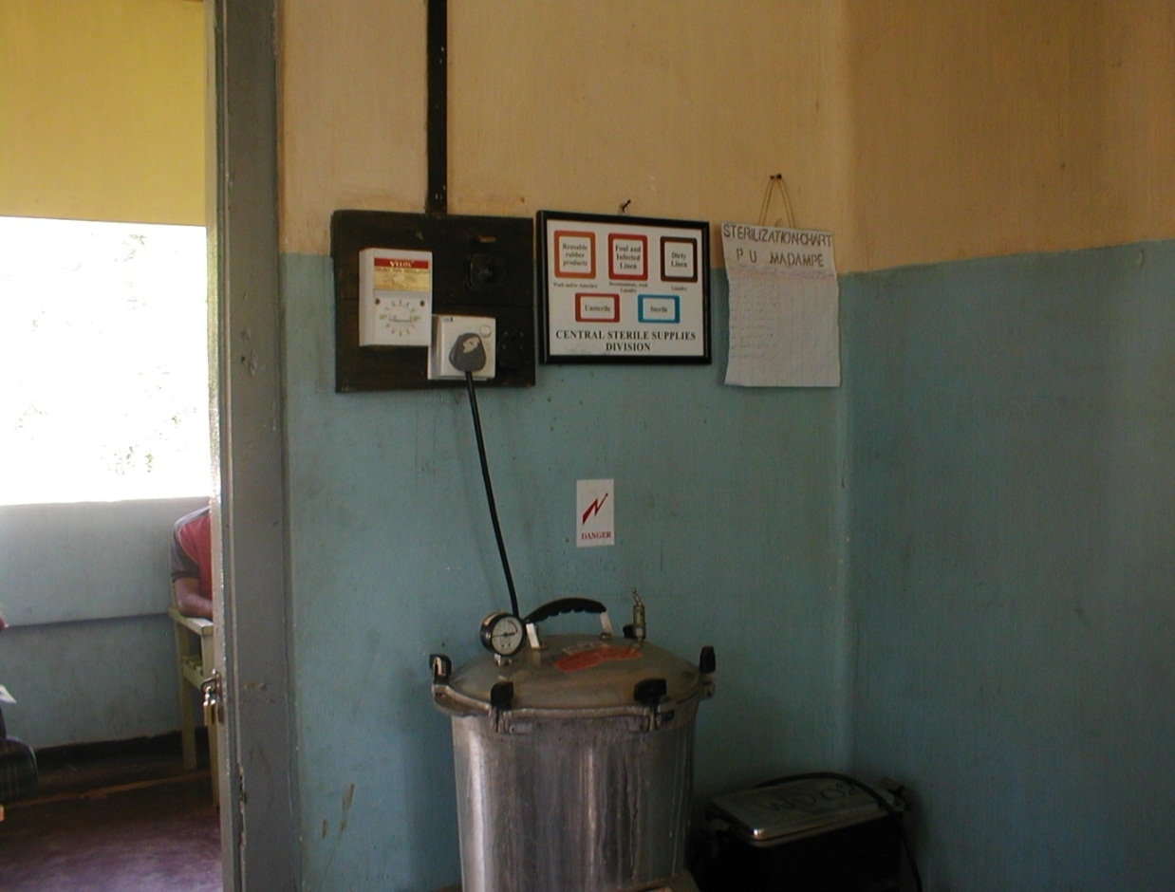
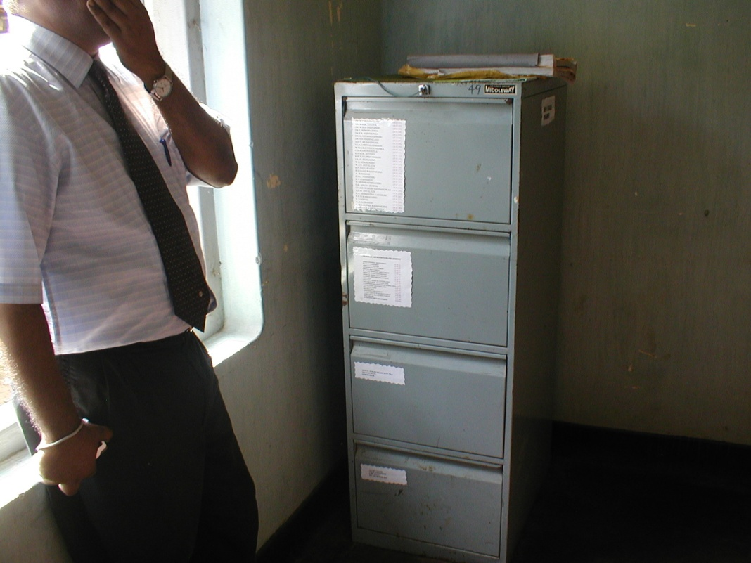
Set
Disposal Segregation
<Example of tools for Set activities>
Colour Coding
Labelling

Slide 15
SUPER5S
1
2
3
4
5
6
7
8
9
10
11
12
Retrieval within 30 seconds
Labeling reserved seats
Color identification
1
2
3
4
5
6
7
8
9
10
11
12
1
2
3
4
5
6
7
8
9
10
11
12

Slide 16
Shine
All staff should participate
Periodical implementation of shining activity – e.g., 10 minutes daily, 20 minutes weekly and 30 minutes monthly etc.
Improve cleaning staff’s work environment
Equipment maintenance (regular cleaning and covering them when not used)

Slide 17
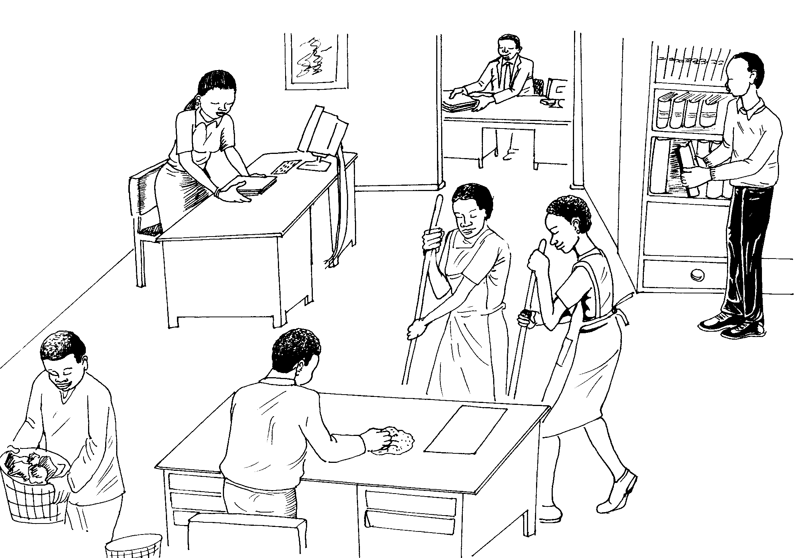
Shine
All personnel in the hospital participate in the activities regardless of category, rank or gender

Slide 18
Standardize
Make 3S activities as a part of routine work for the staff
Visualize the slogans
Standardize the color coding system
Monitoring and evaluation

Slide 19
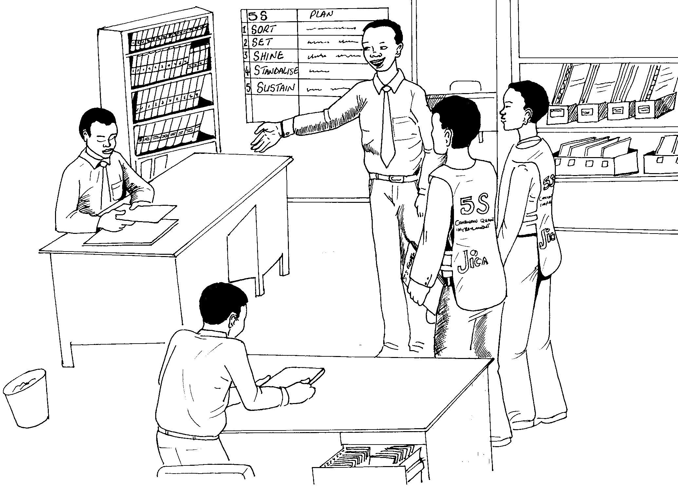
Standardize
Visualizing Slogans
Monitoring

Slide 20
Sustain
Improvement of self discipline through training to all staff starting from nurses, doctors and other staff
Orientation during the WIT meetings
Stimulation to WITs through positive competition

Slide 21
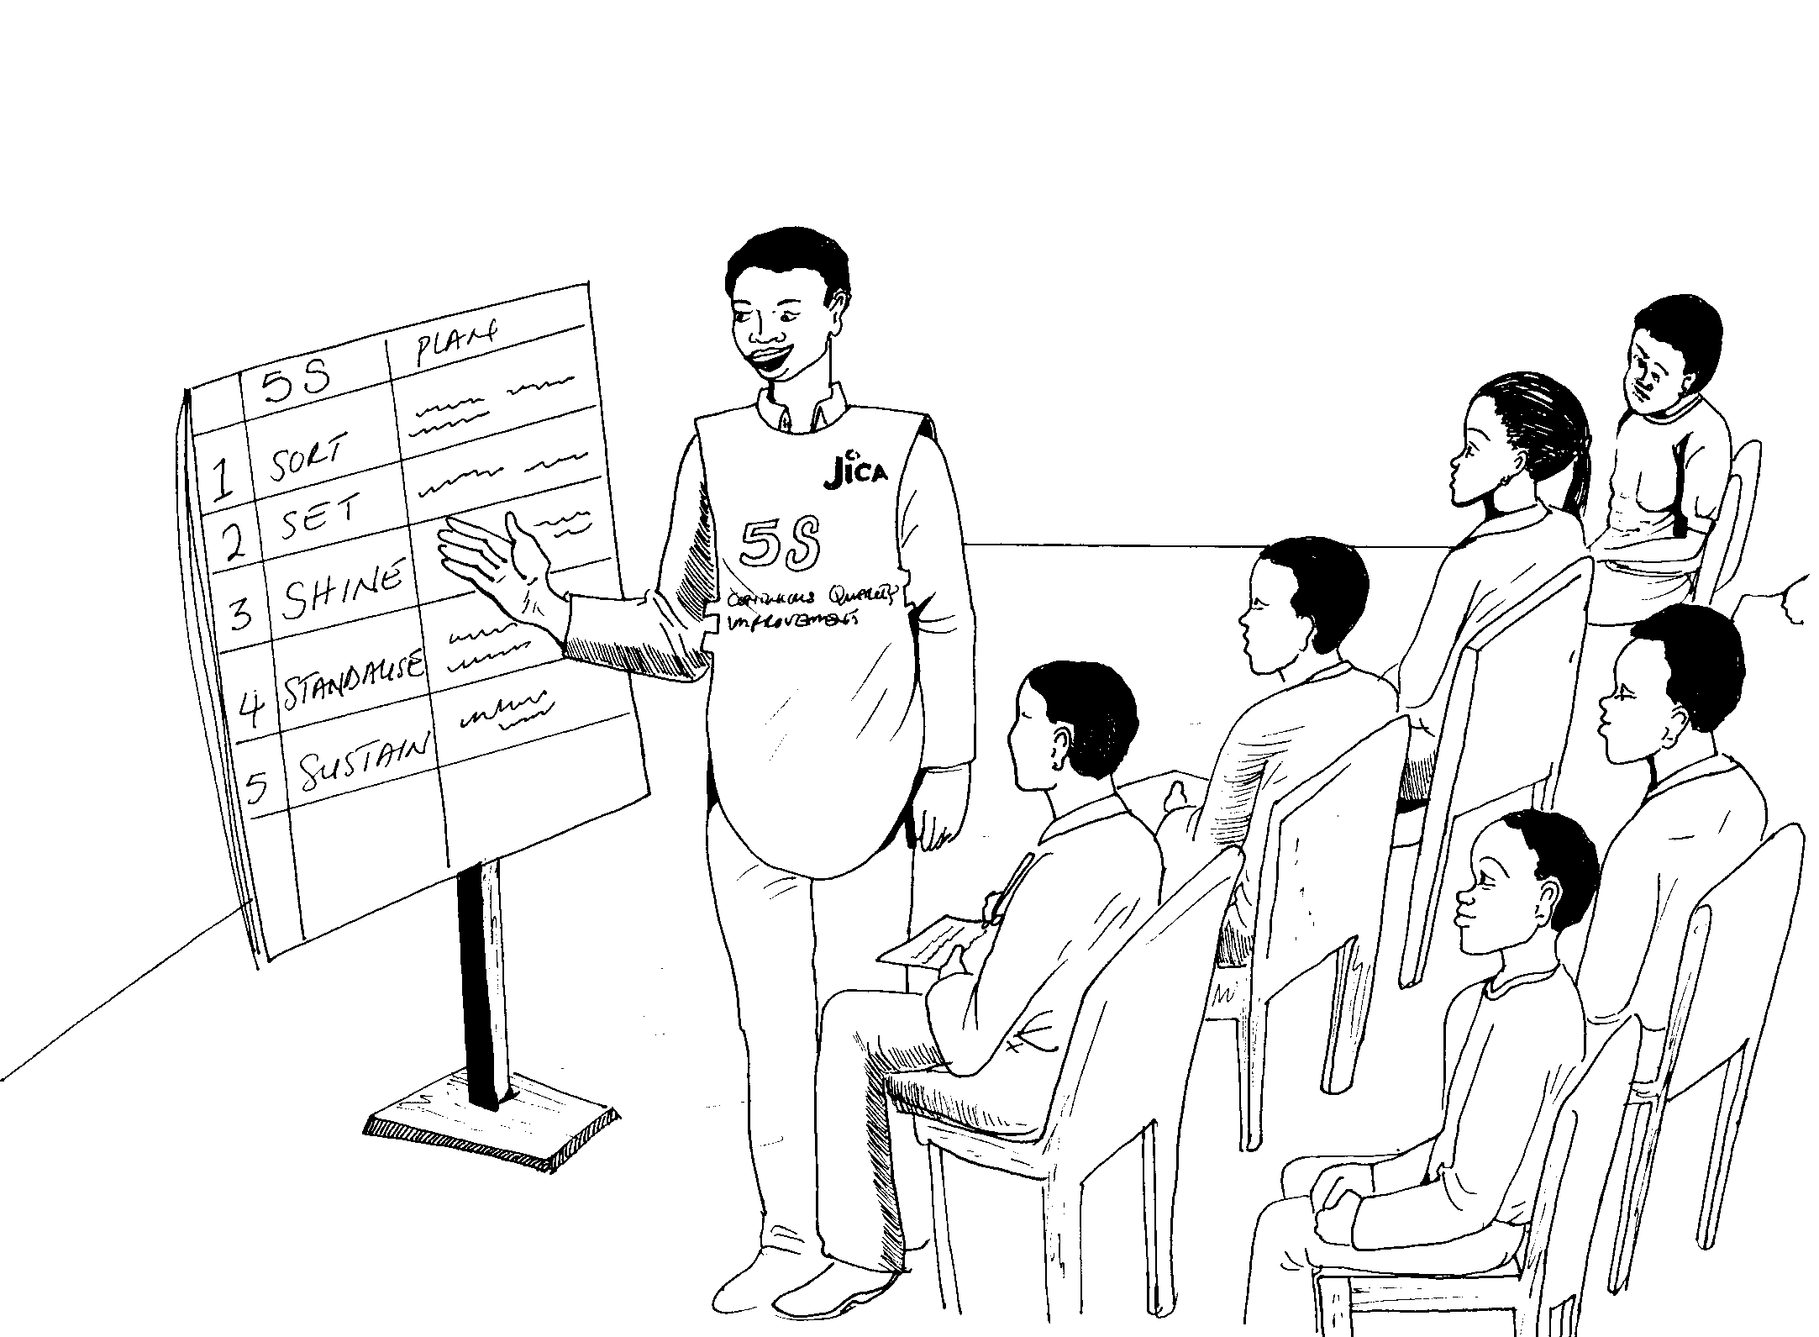
Sustain (Shitsuke)
Introductory training to nursing officers and midwives, then to doctors by top management or QIT team leader

Slide 22
5S TOOLS
Red Tag
Alignment
X-axis Y-axis Theory
Numbering
Alphabetical order
Ascending order
Left to Right order
Top to Bottom order
Zones
Labeling
Symbols
Street lines
Name boards
Directions
Safety signs
Check lists
Instructions sheets
Color code

Slide 23
5S Activities: Implementation
Train the hospital staff
Support implementation
of 5S activities
Monitor & assess
achievements of WITs
Coaching the WITs
Taking leadership &
support 5S activities.
Learn and practice 5S
principles by him/herself
Top management
Implement 5S in respective
work units/division
Conduct periodical
monitoring
Reporting to QIT
Quality Improvement
Team
[5 - 15 persons]
Work Improvement
Team
[3 - 5 persons]
Work Improvement
Team
[3 - 5 persons]
Work Improvement
Team
[3 - 5 persons]

Slide 24
Relationship between 5S Activities and
TQM Framework
TQM Framework
Improvement of the Quality of Product and Services by Total Quality Management (TQM)
Change the working process by Kaizen (Continuous Quality Improvement)
Work Environment Improvement through 5S Activities
5S Activities are the Entry Point to the TQM Framework

Slide 25



KAIZEN(CQI)
A frontline-based problem solving approach
Incremental but continuous progress

Slide 26


INNOVATION
Dramatic but intermittent progress
THE IDEAL
ACTUALITY
Higher standard achieved through innovation is subject to deterioration unless continuing efforts are made first to maintain it and then to improve it

Slide 27
KAIZEN PLUS INNOVATION
Desirable progress by combination of two opposing approaches
MAINTENANCE
INNOVATION
NEW STANDARD
KAIZEN
MAINTENANCE
INNOVATION

Slide 28
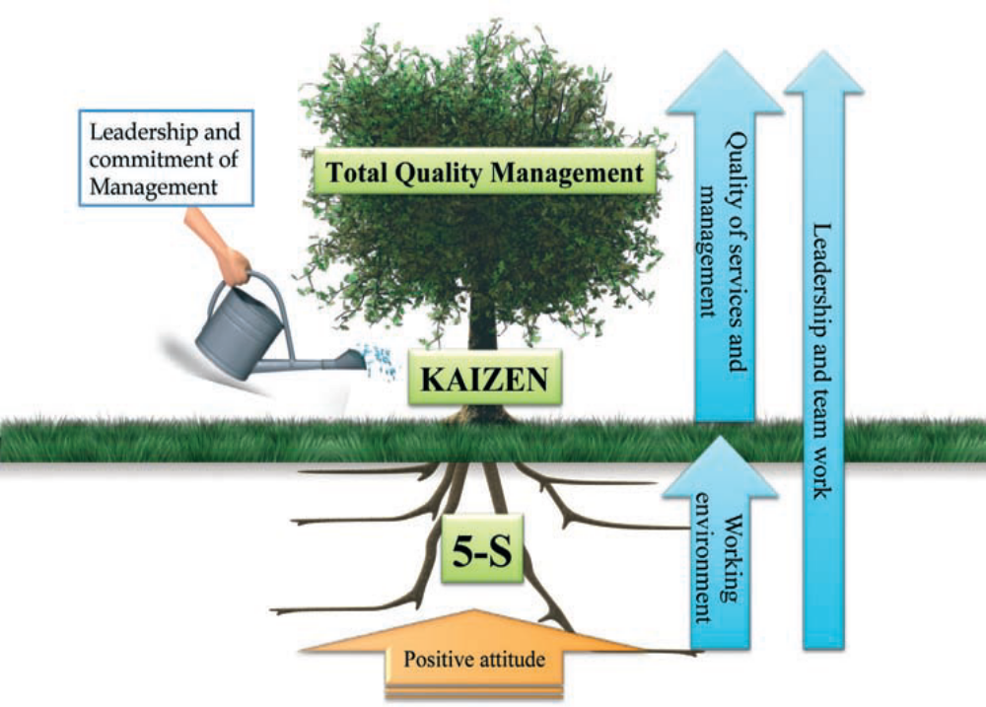

Slide 29
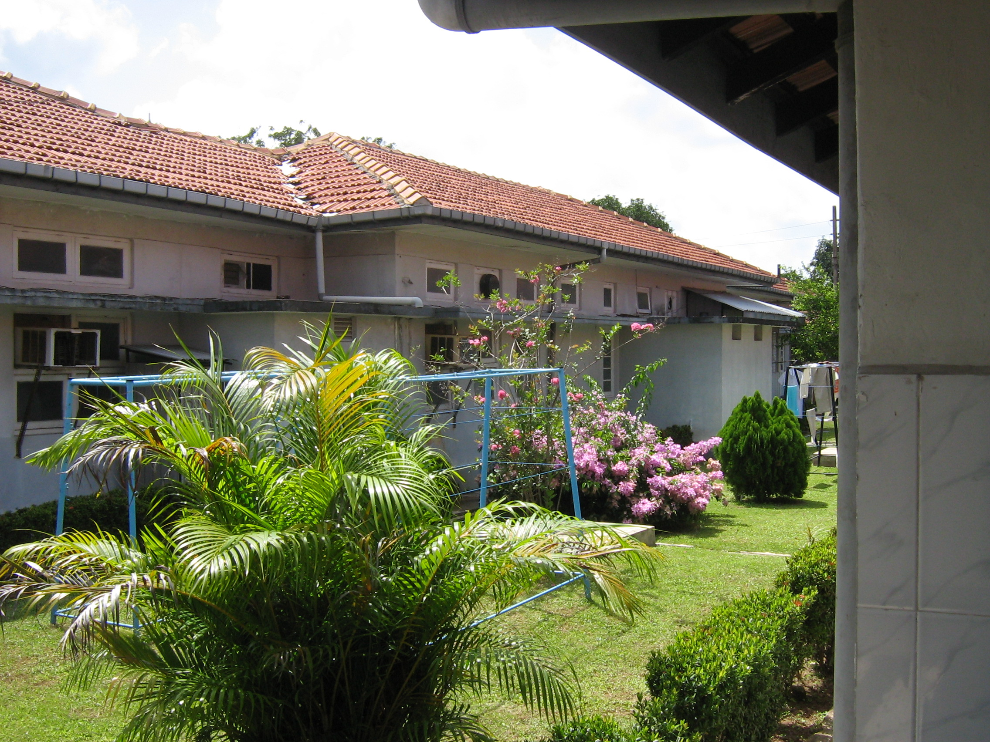

Slide 30
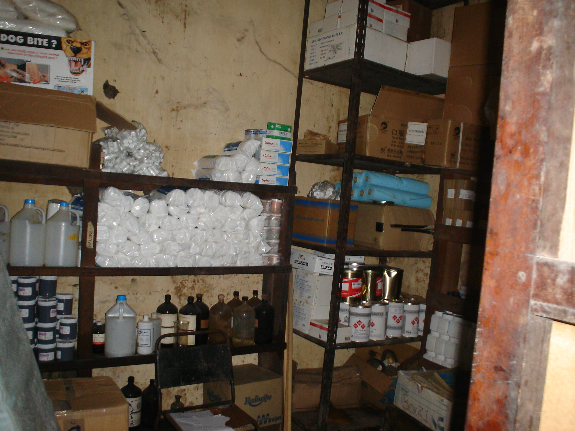

Slide 31
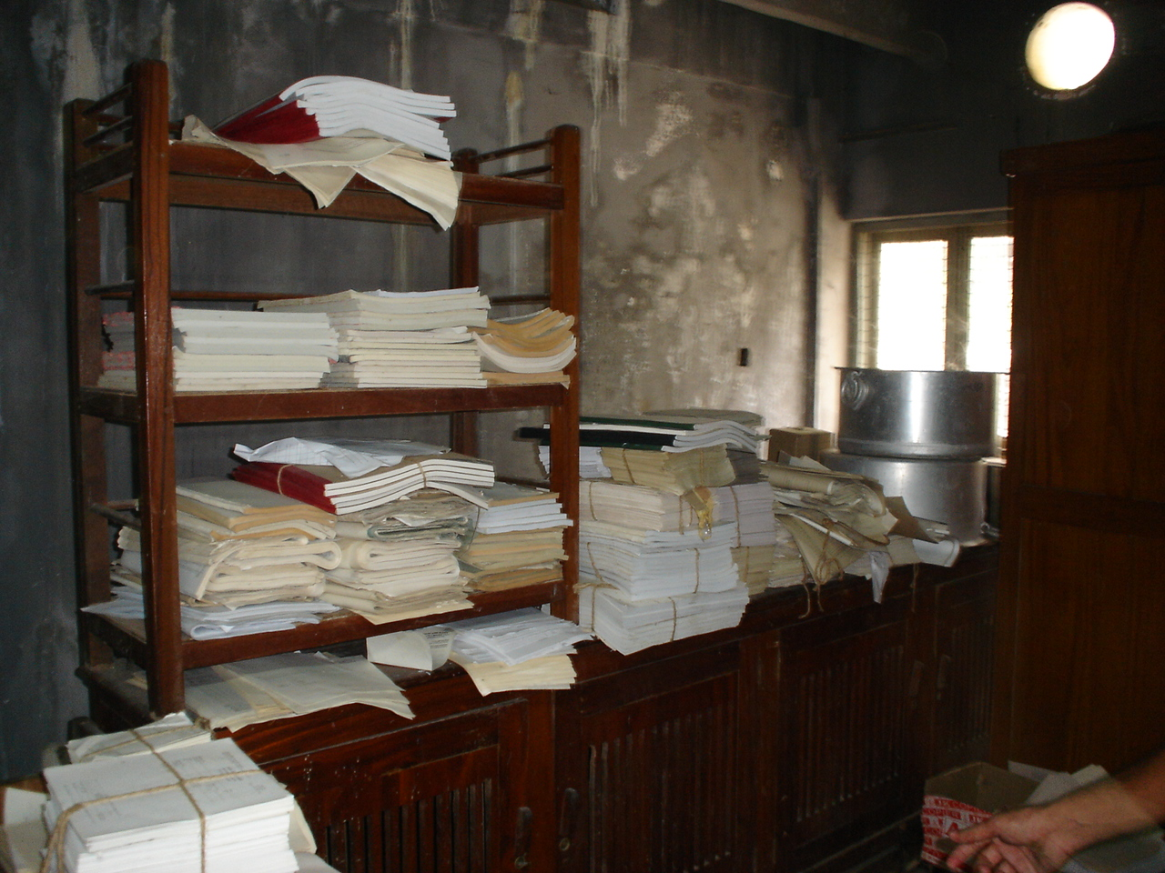

Slide 32
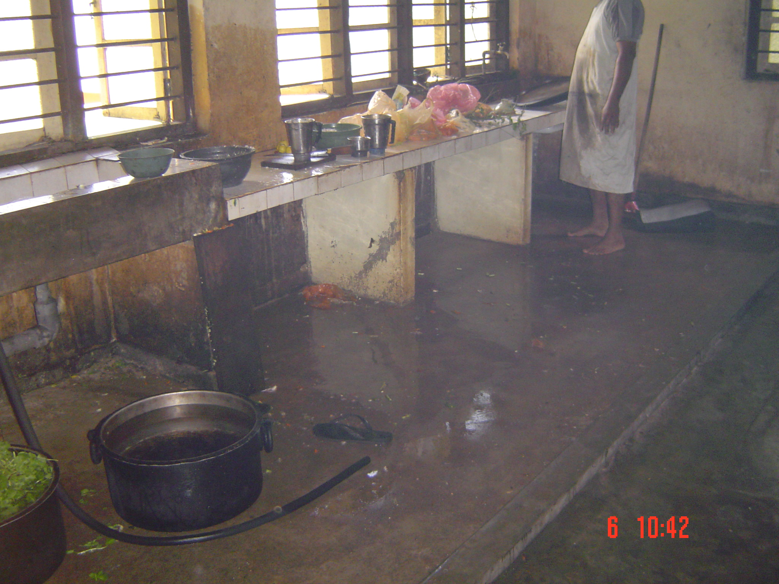

Slide 33
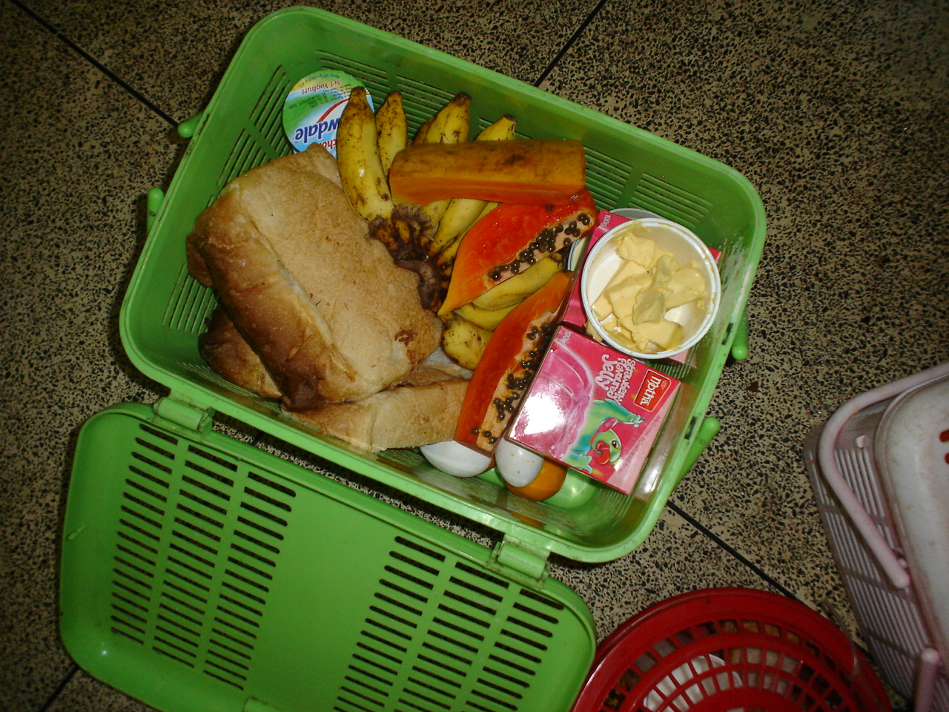

Slide 34
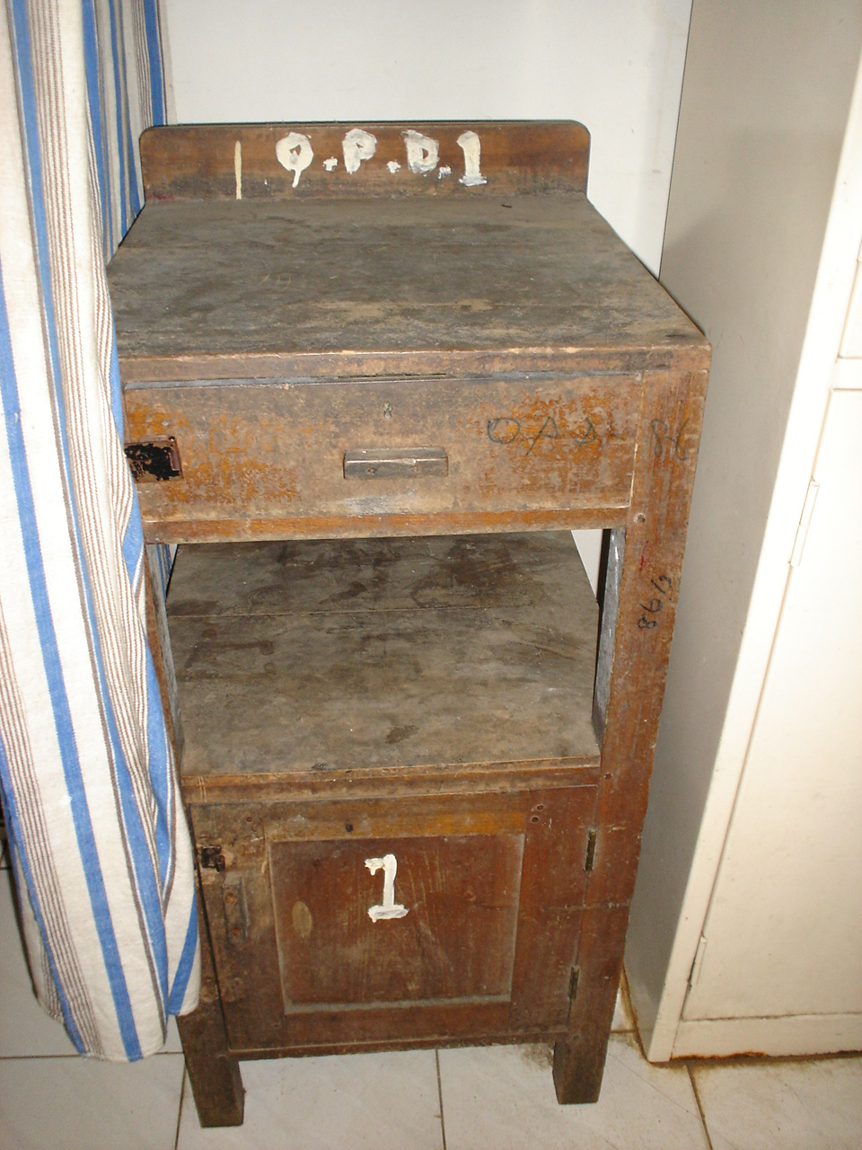

Slide 35
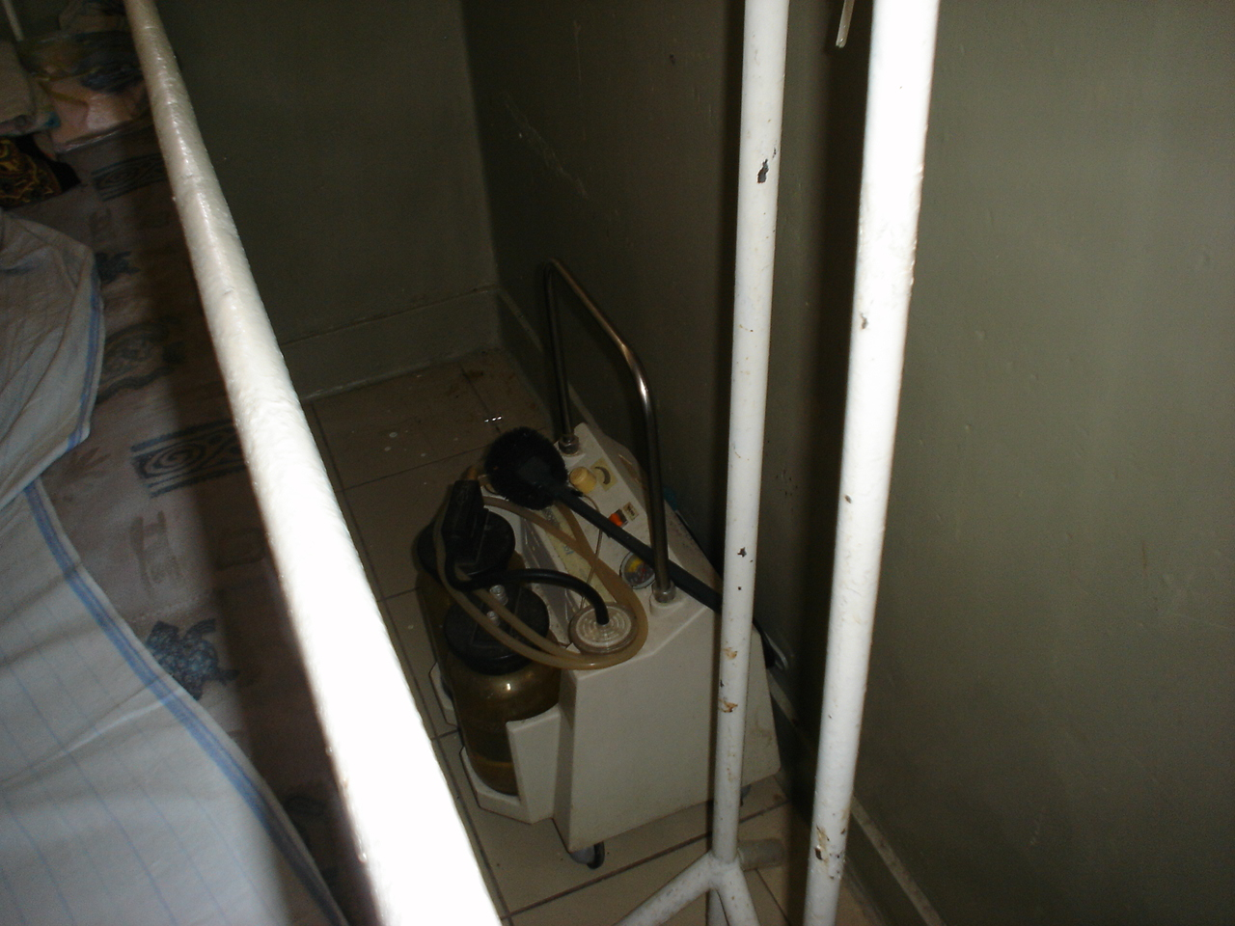

Slide 36
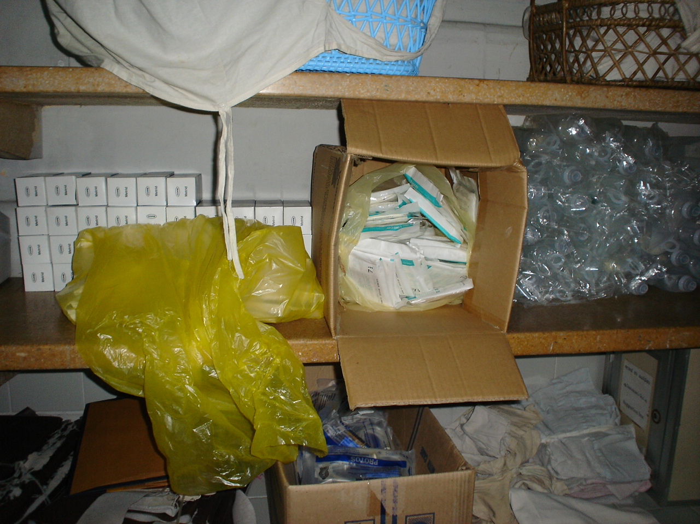

Slide 37
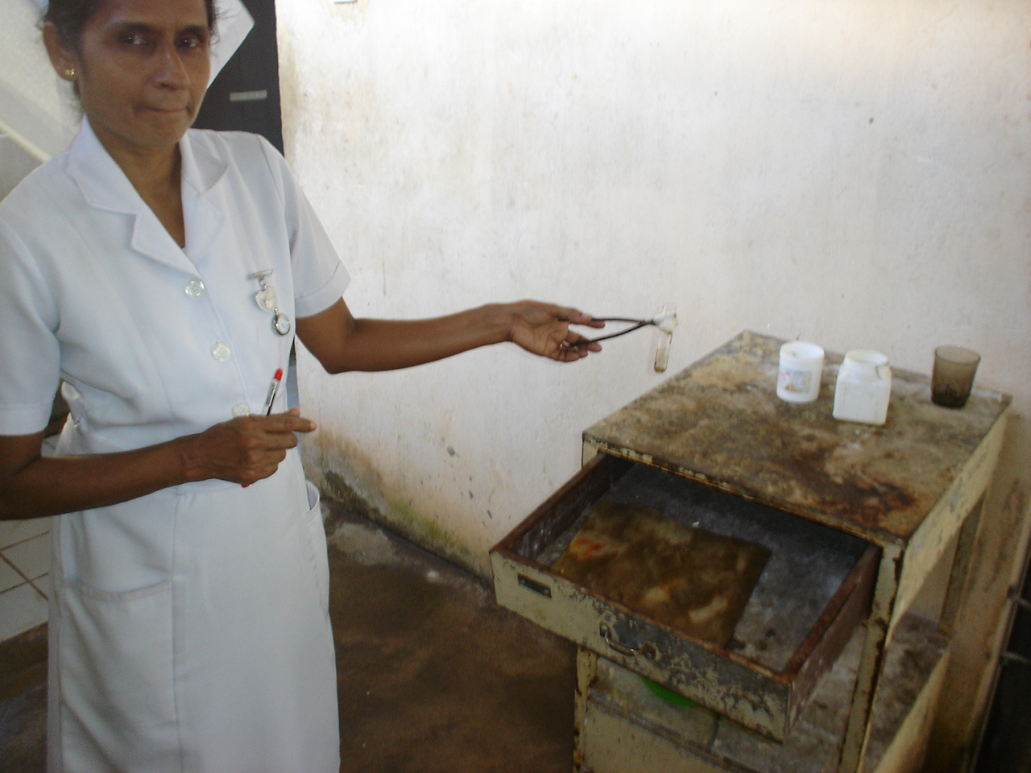

Slide 38
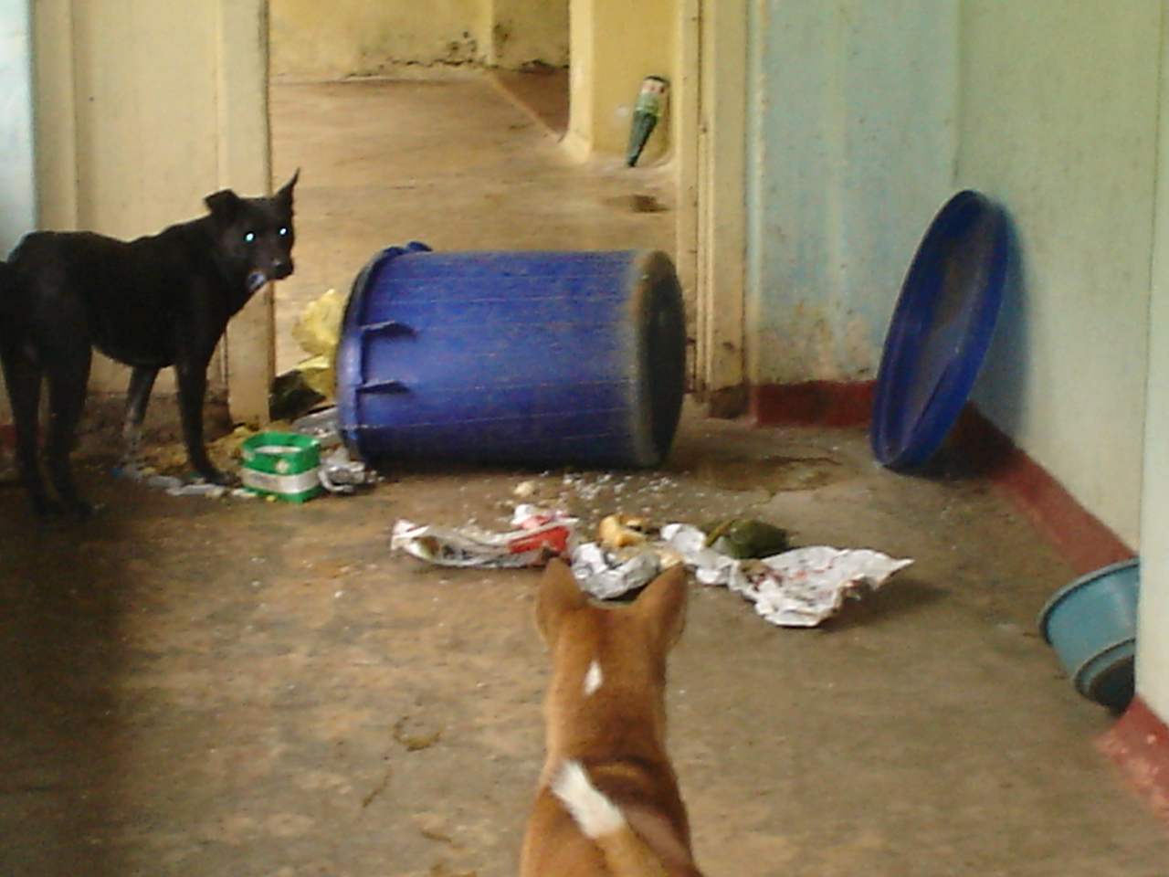

Slide 39
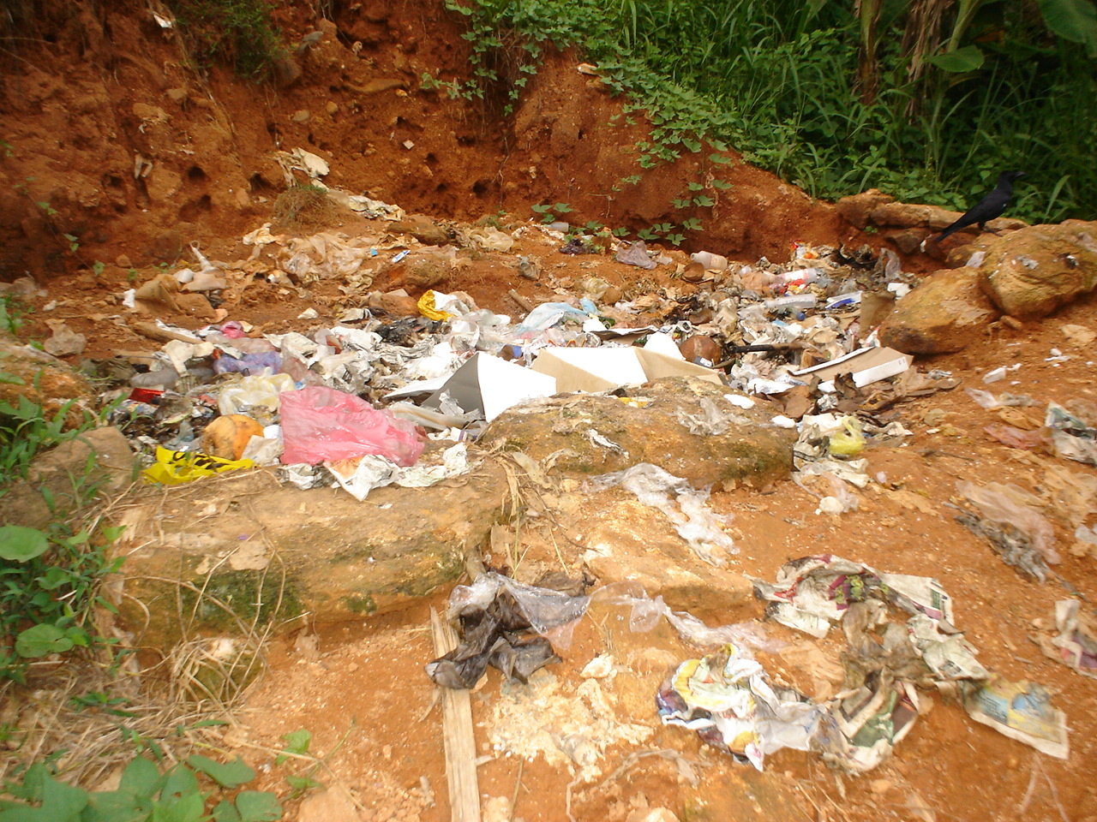

Slide 40
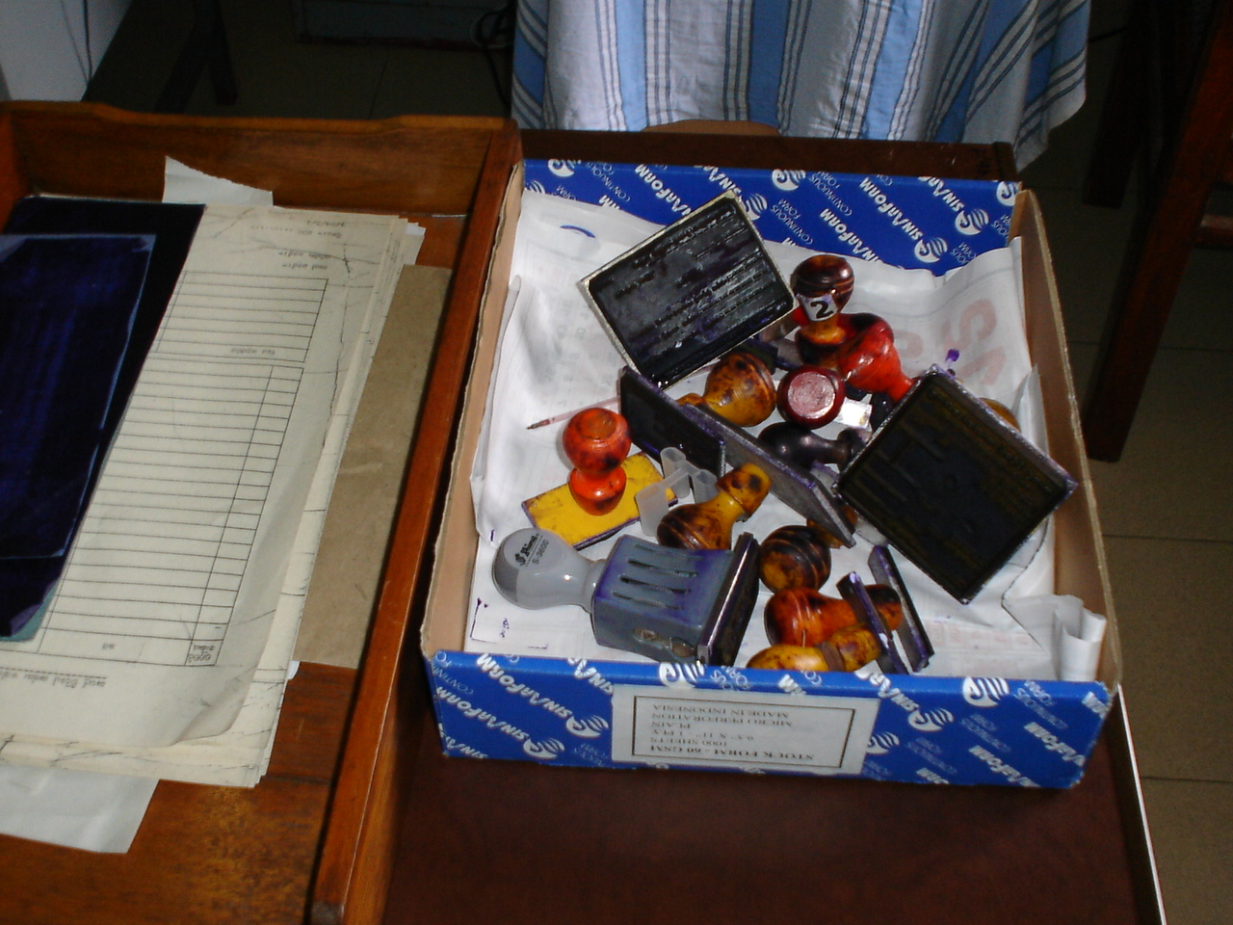

Slide 41
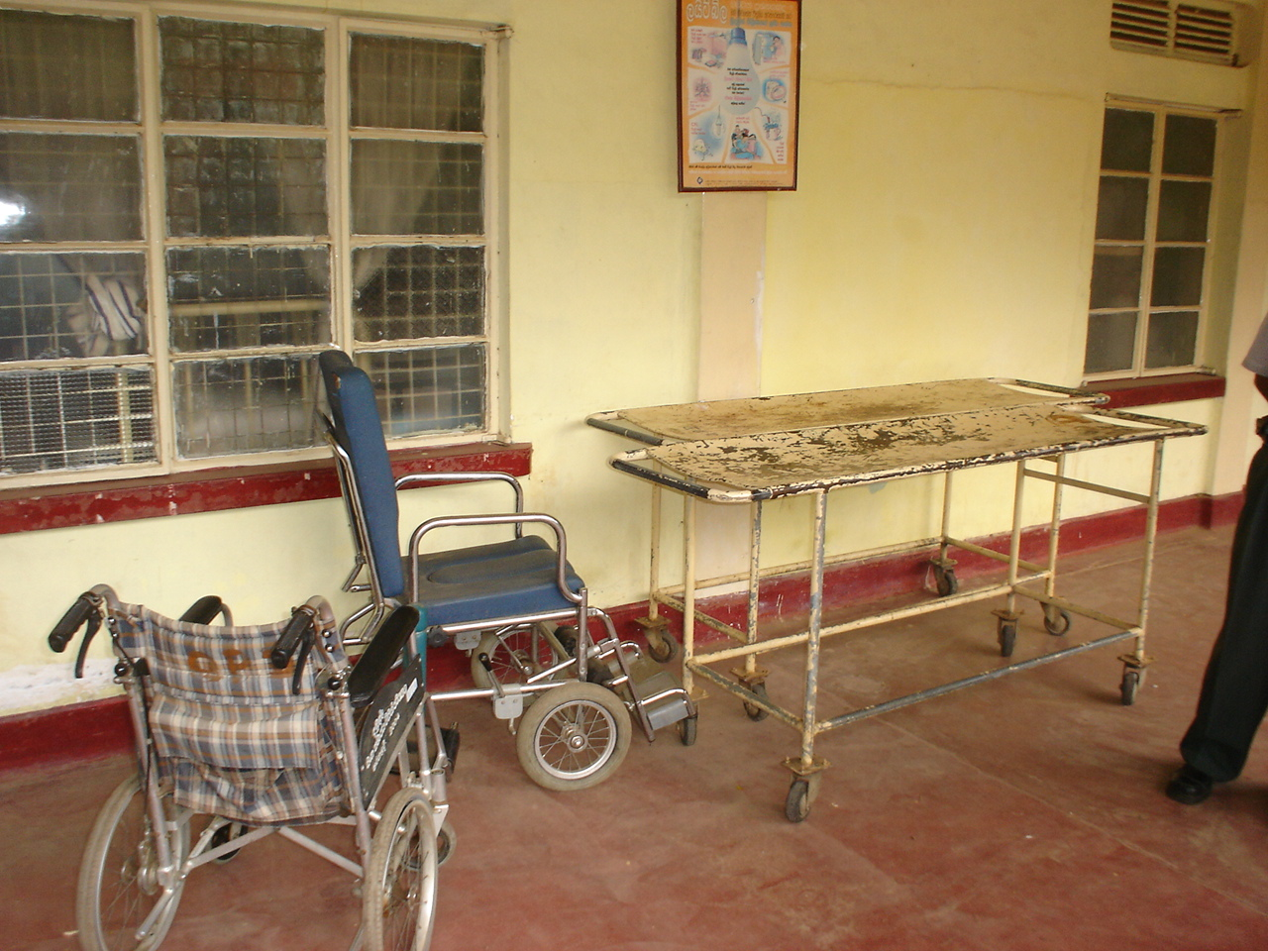

Slide 42
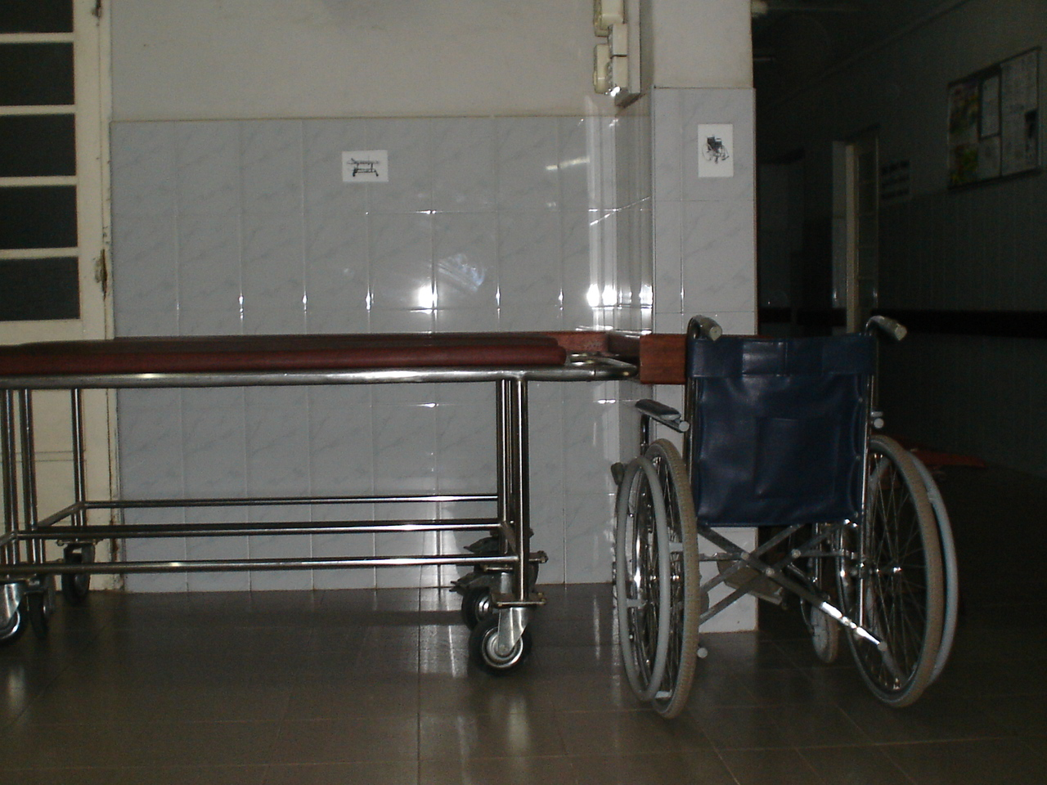

Slide 43
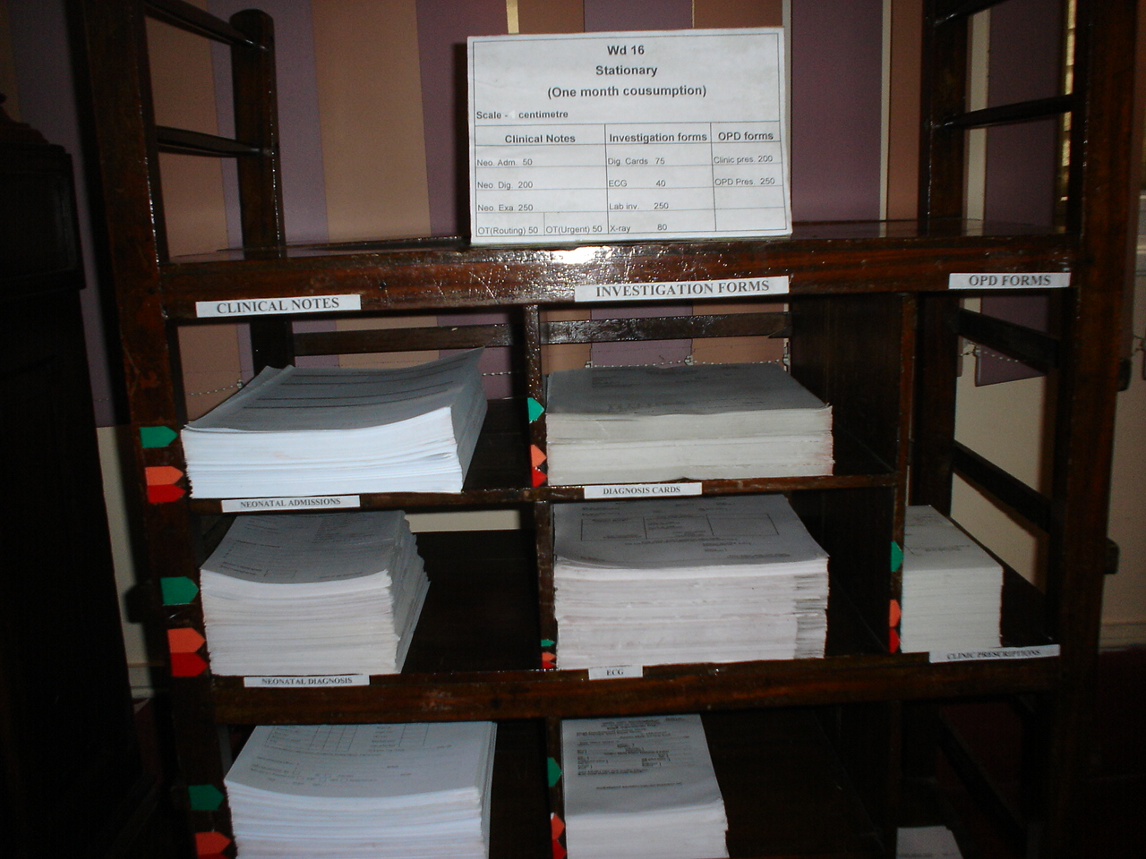

Slide 44
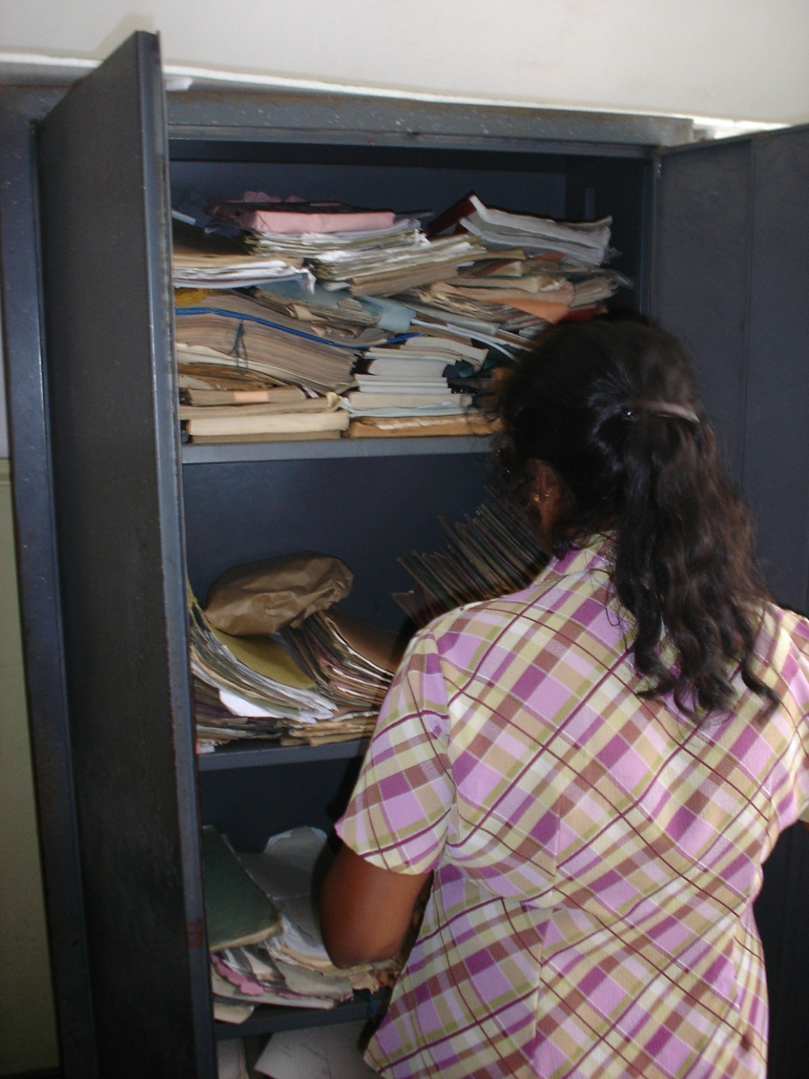
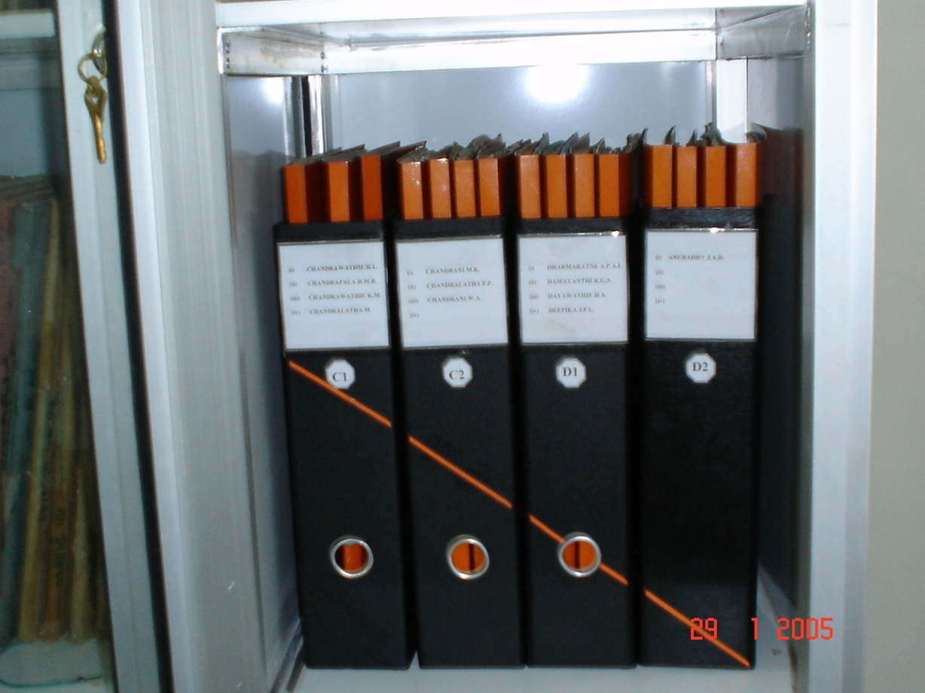

Slide 45
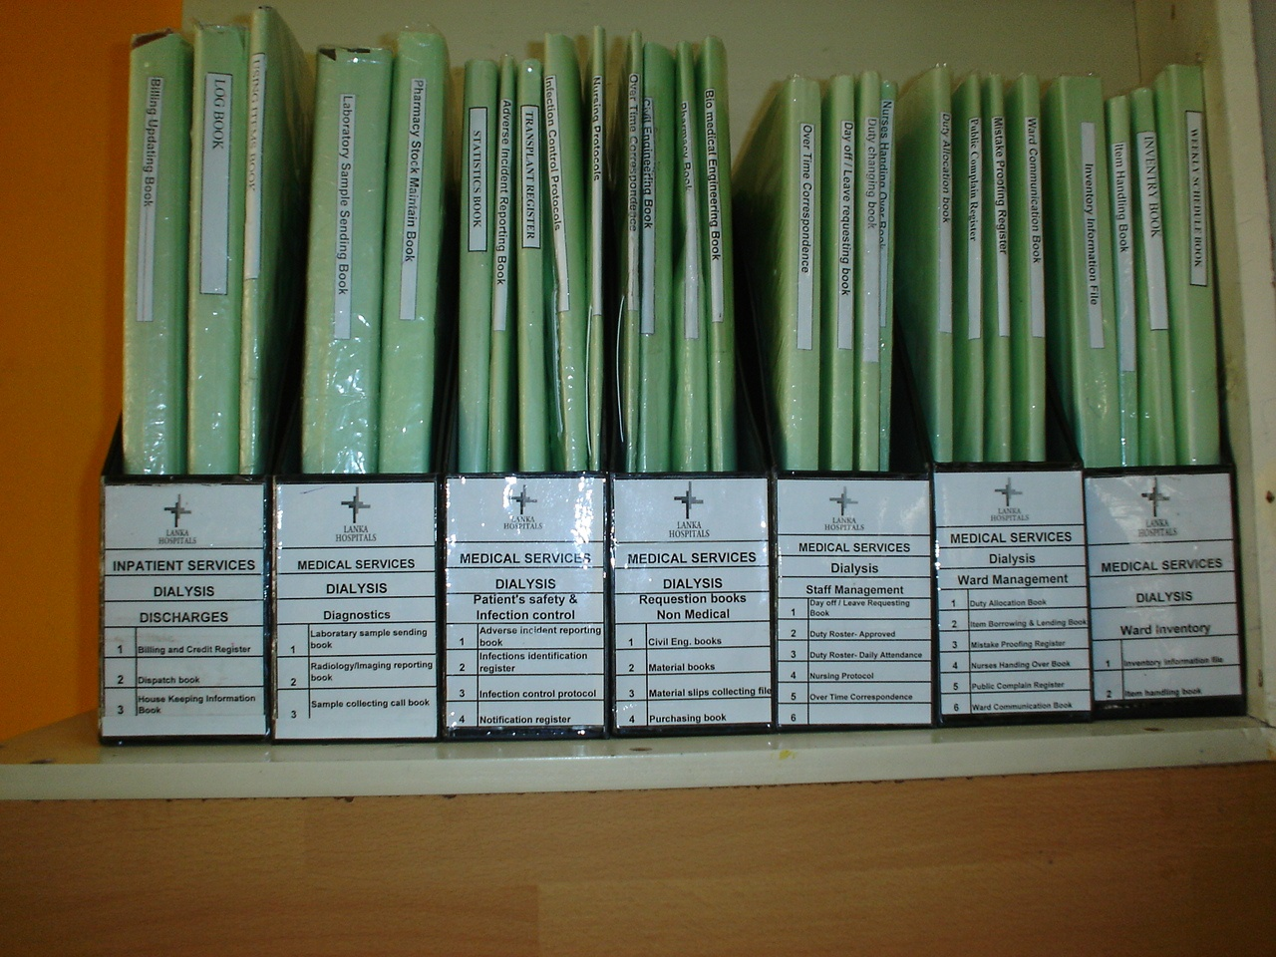

Slide 46
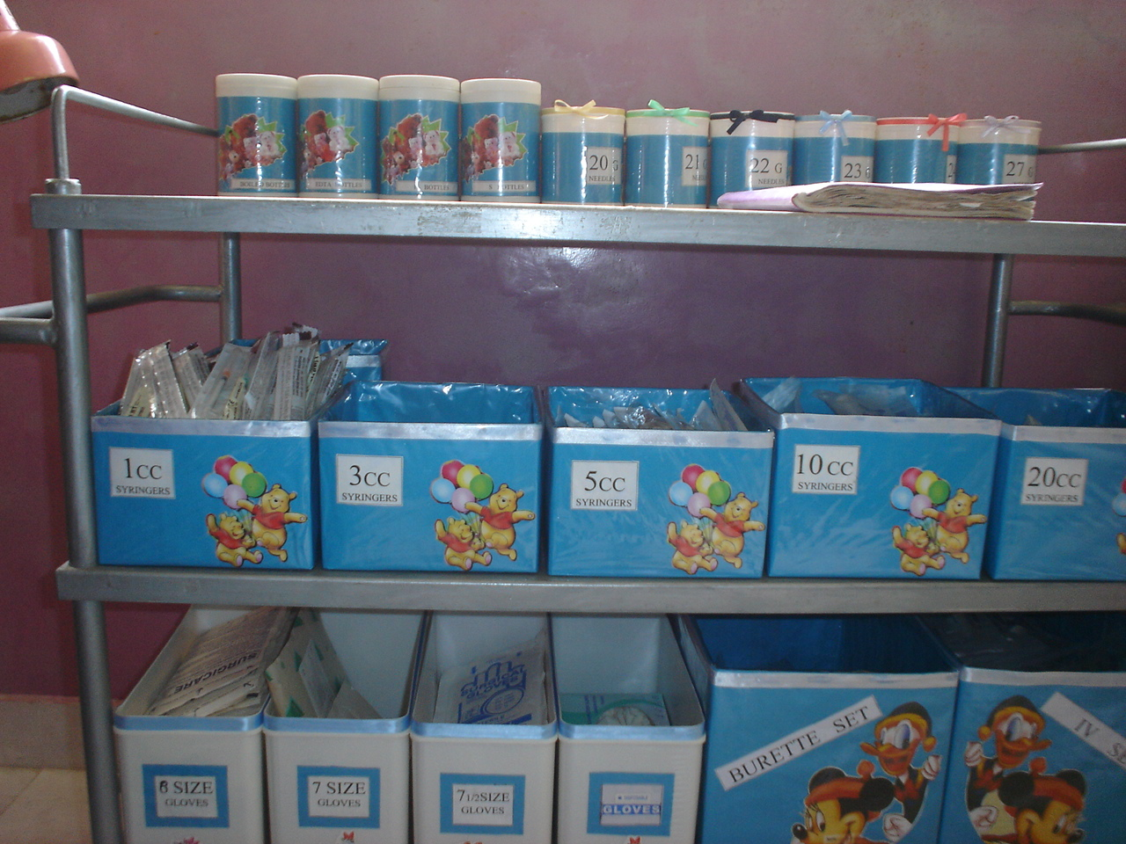

Slide 47

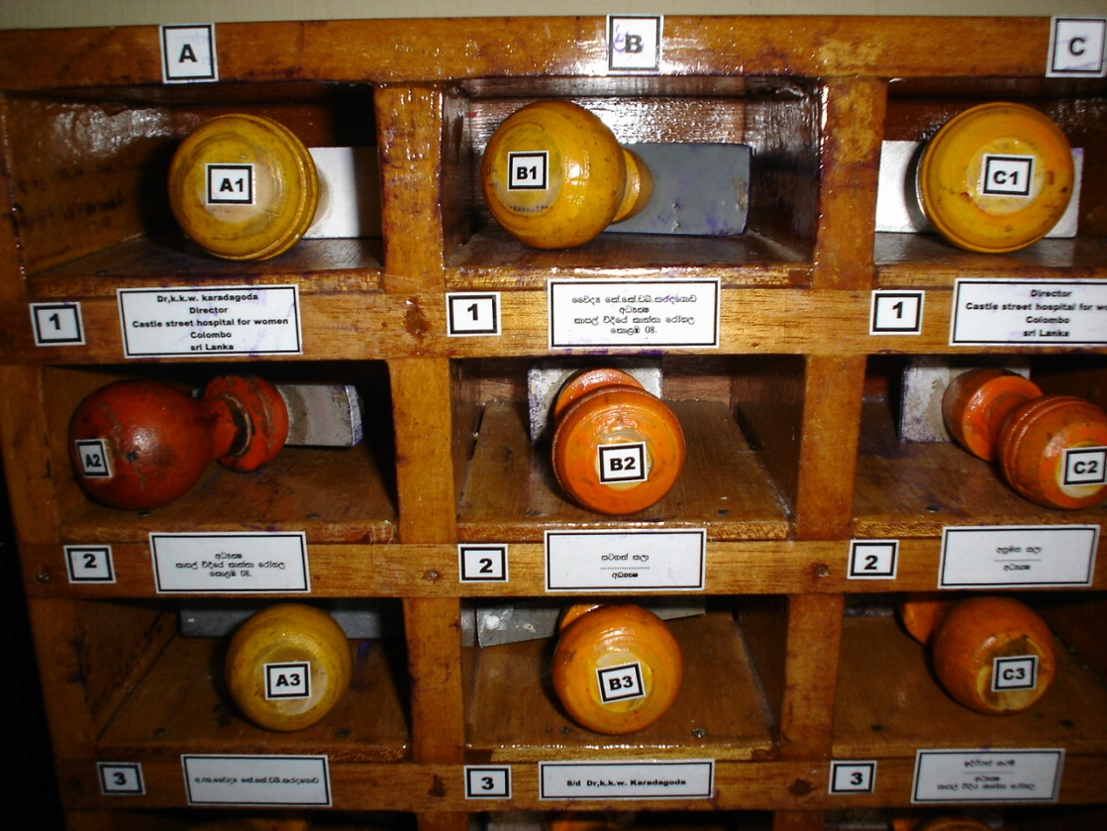

Slide 48
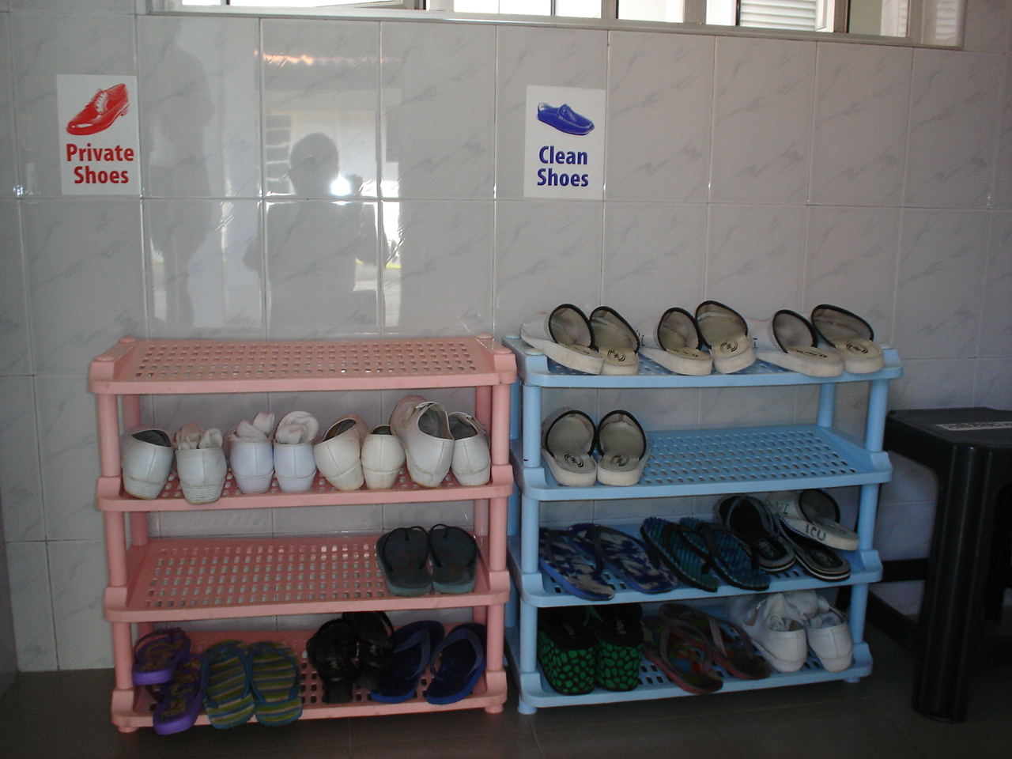

Slide 49
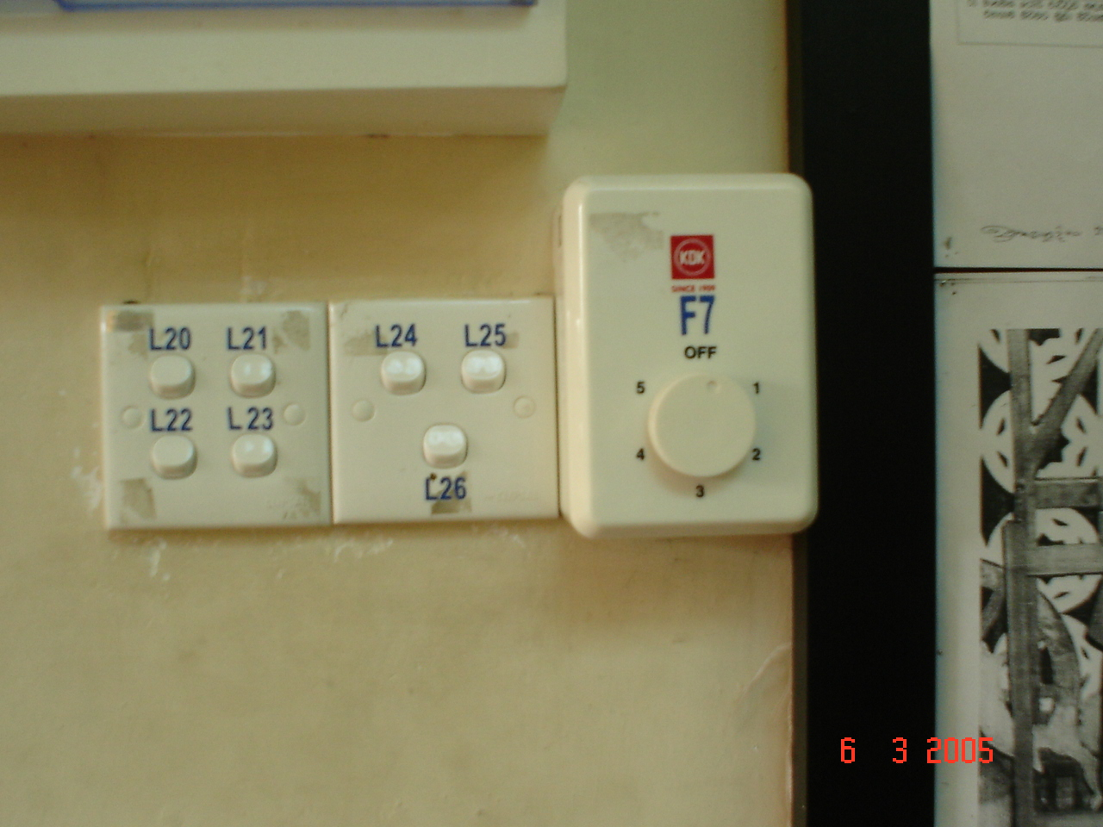

Slide 50
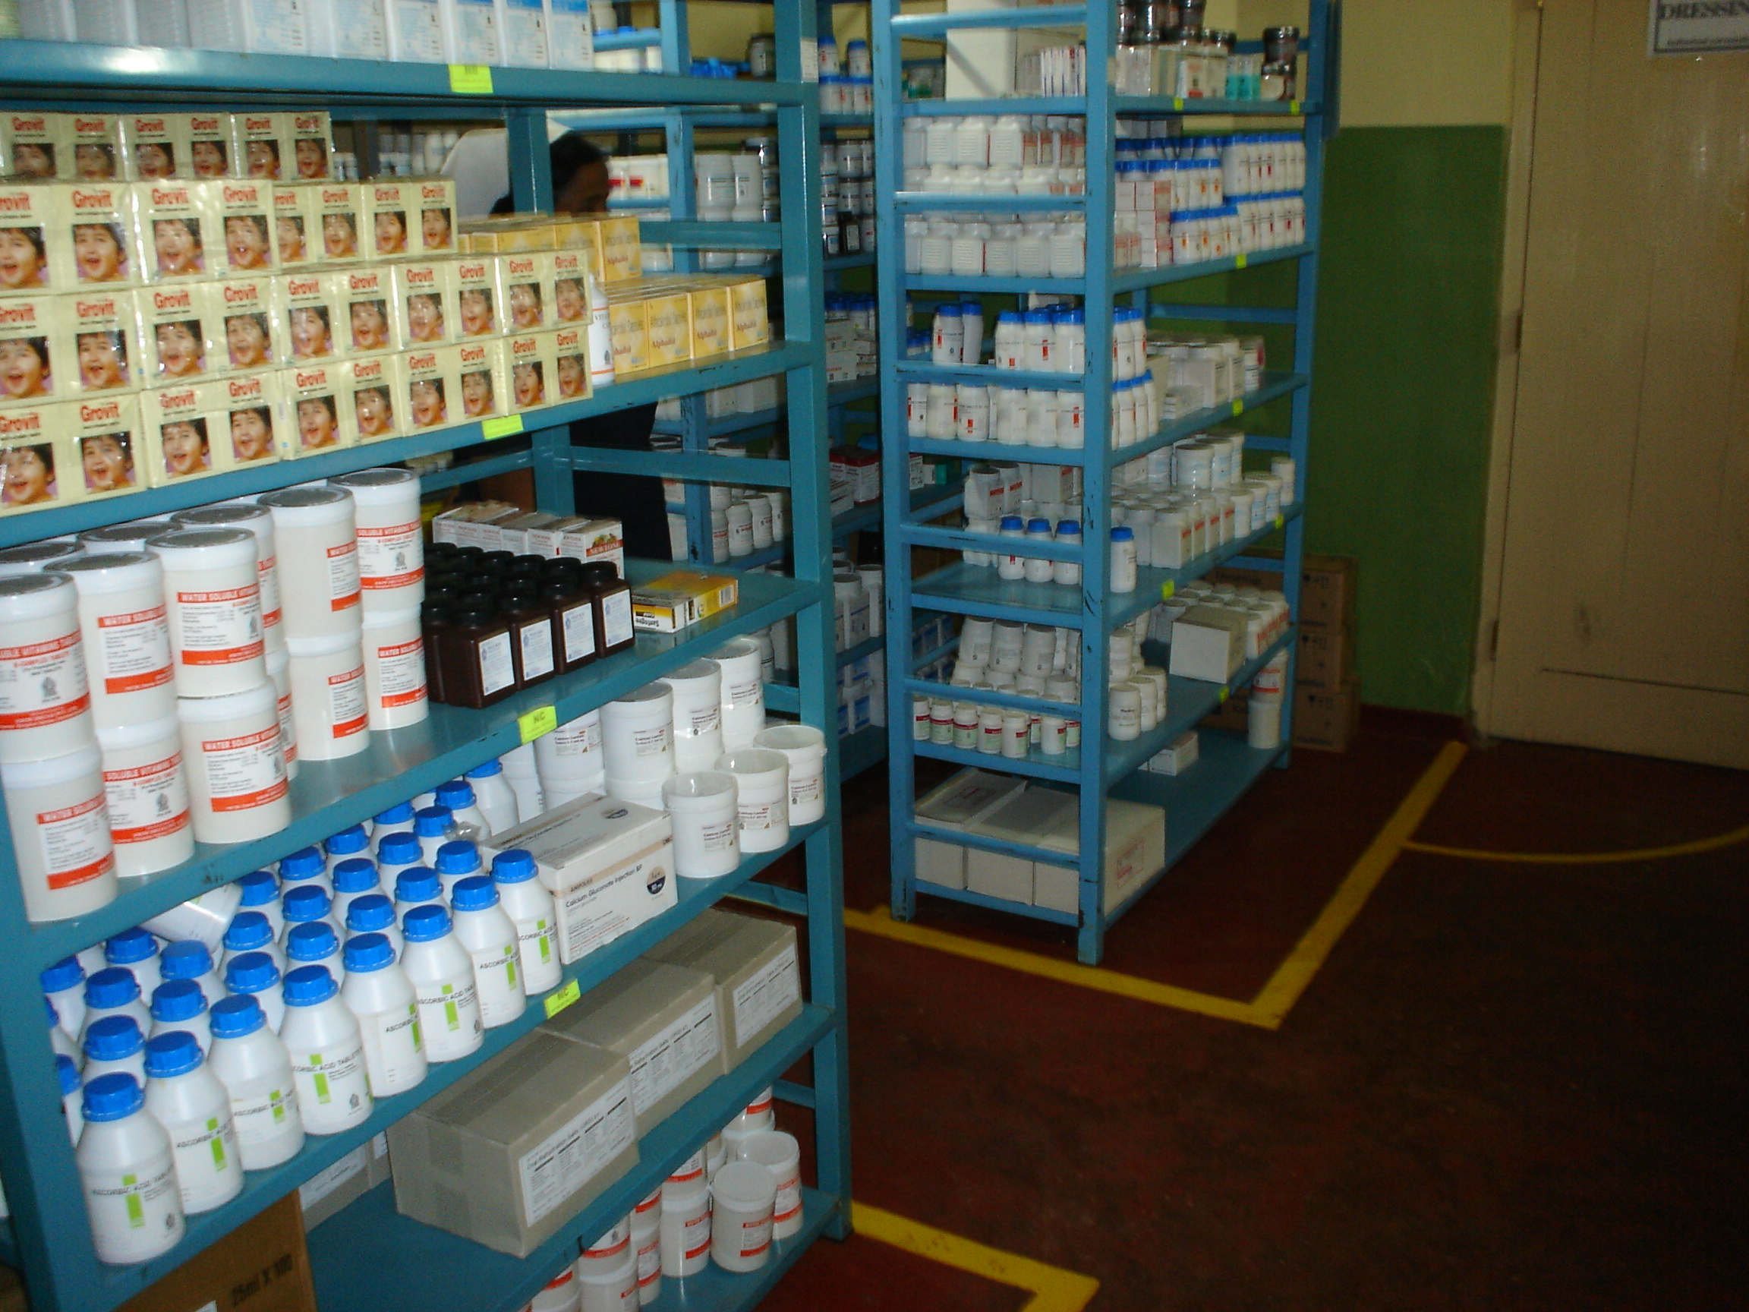

Slide 51
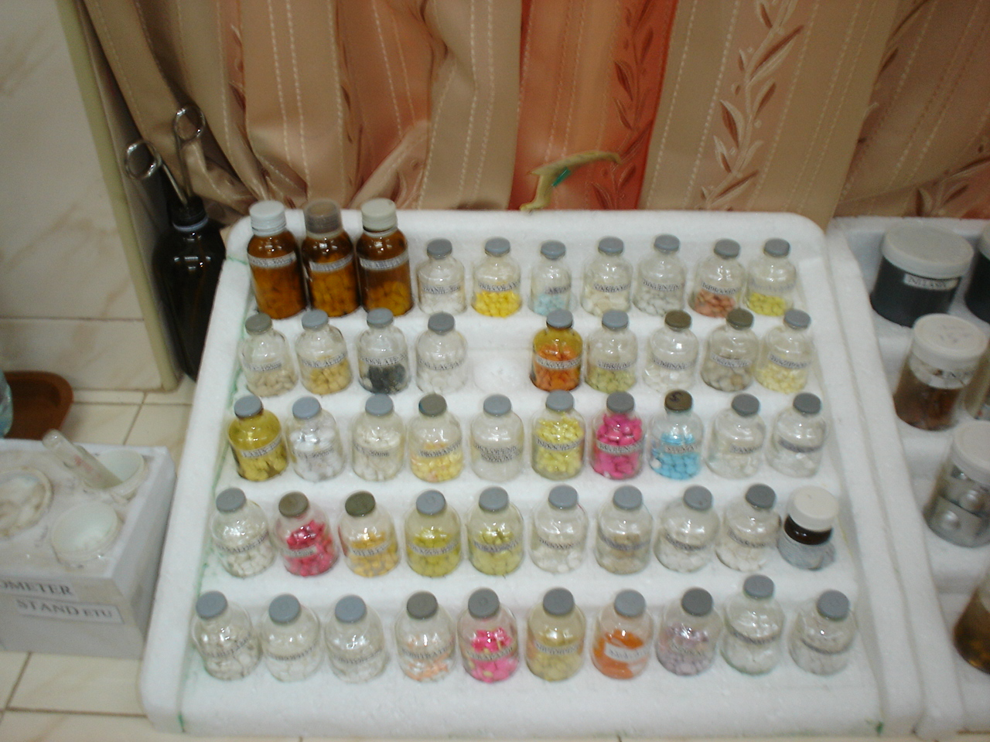

Slide 52
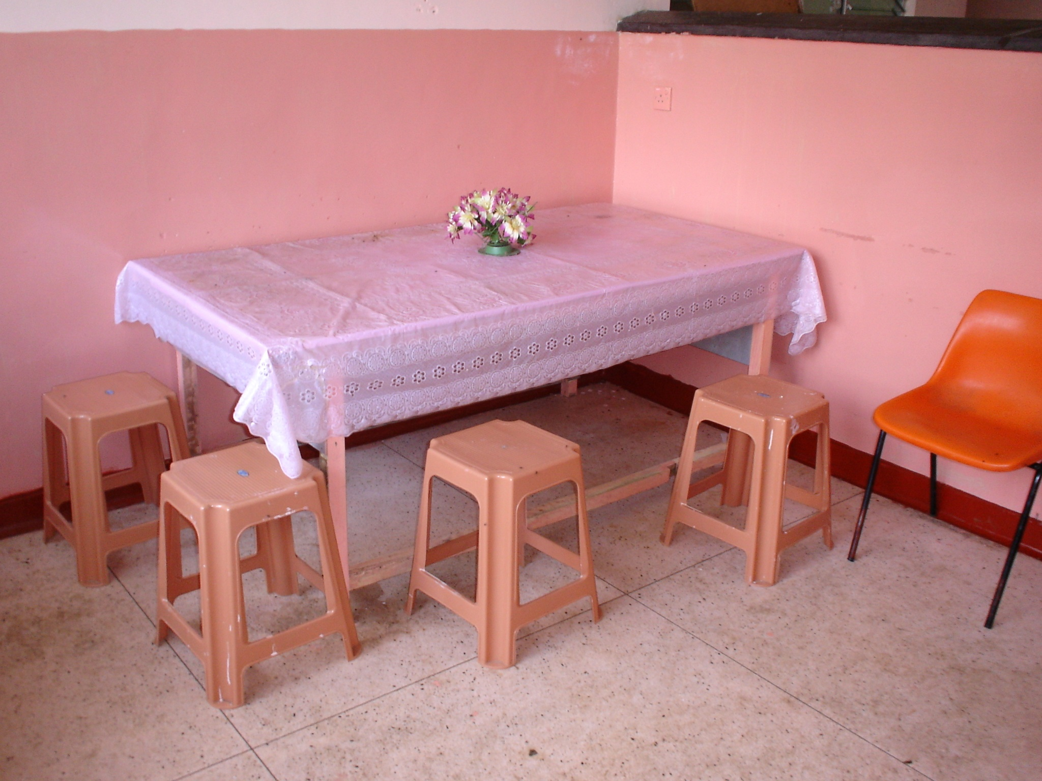

Slide 53
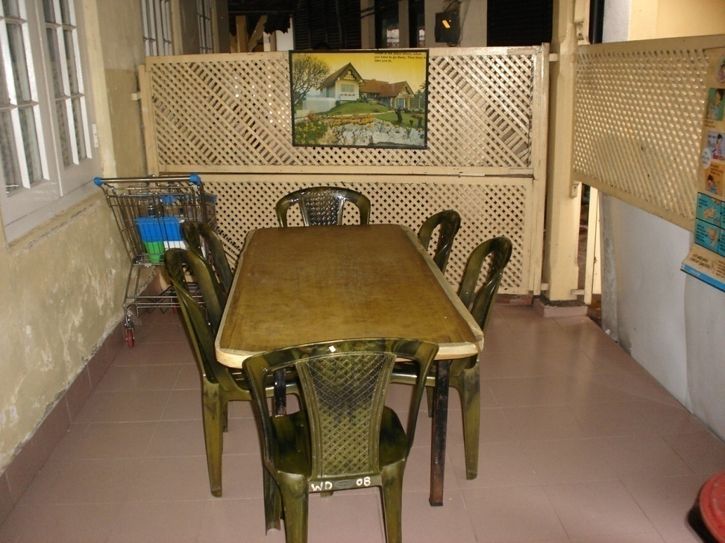
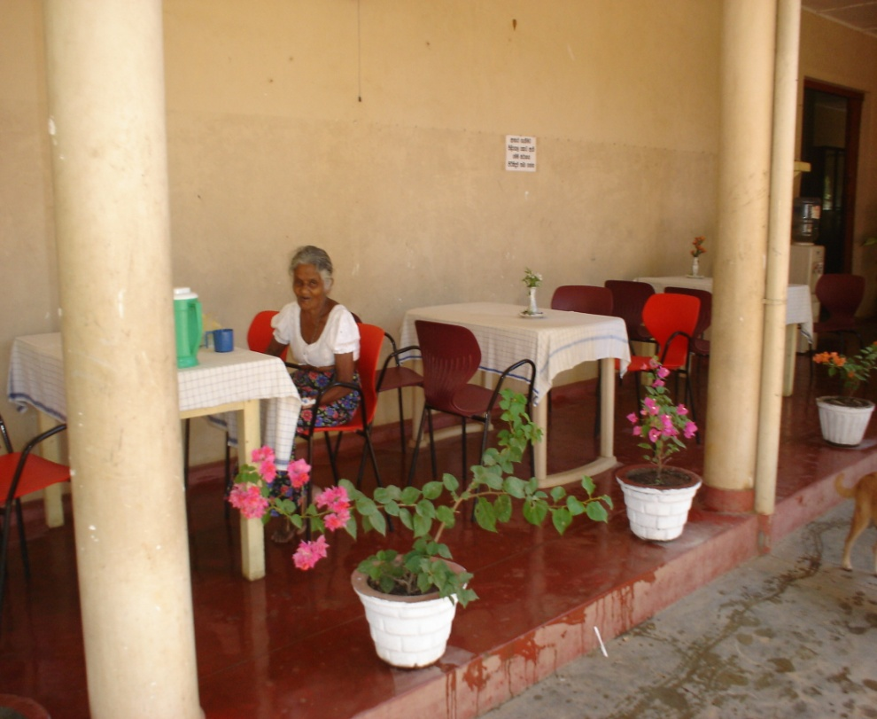

Slide 54
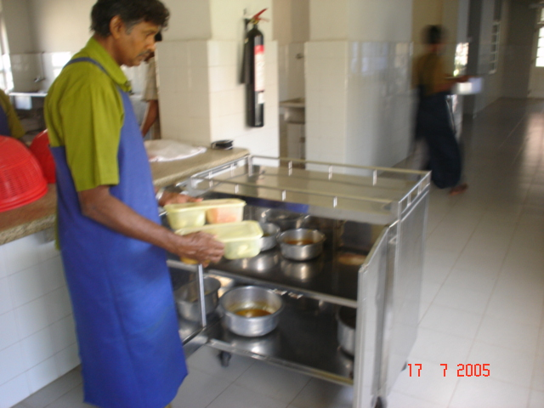

Slide 55
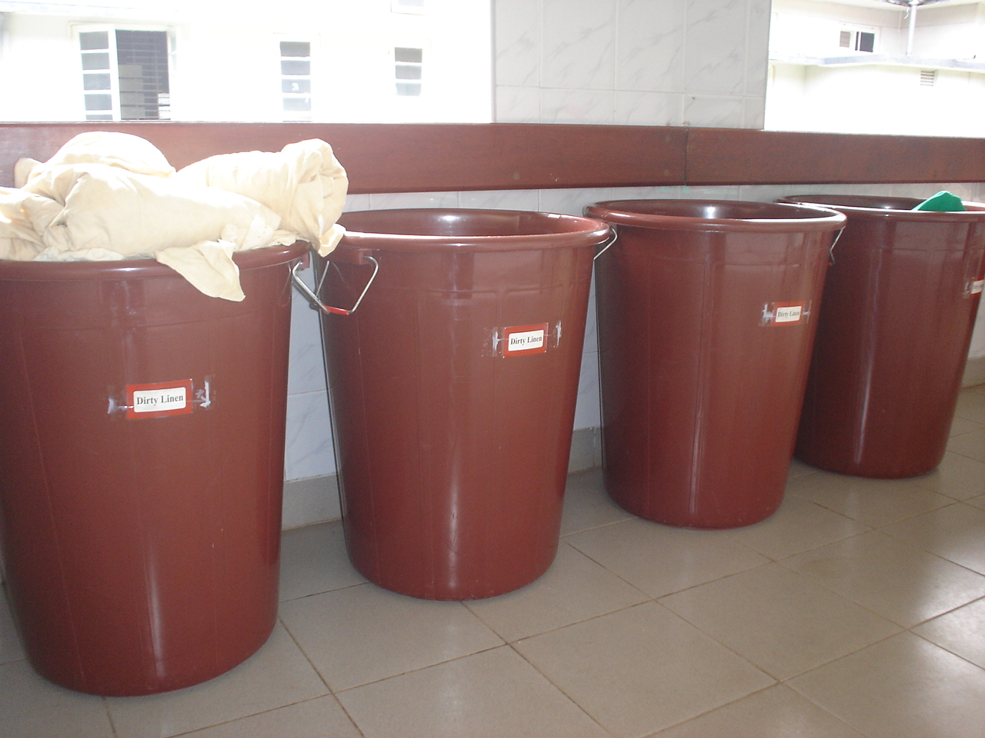

Slide 56
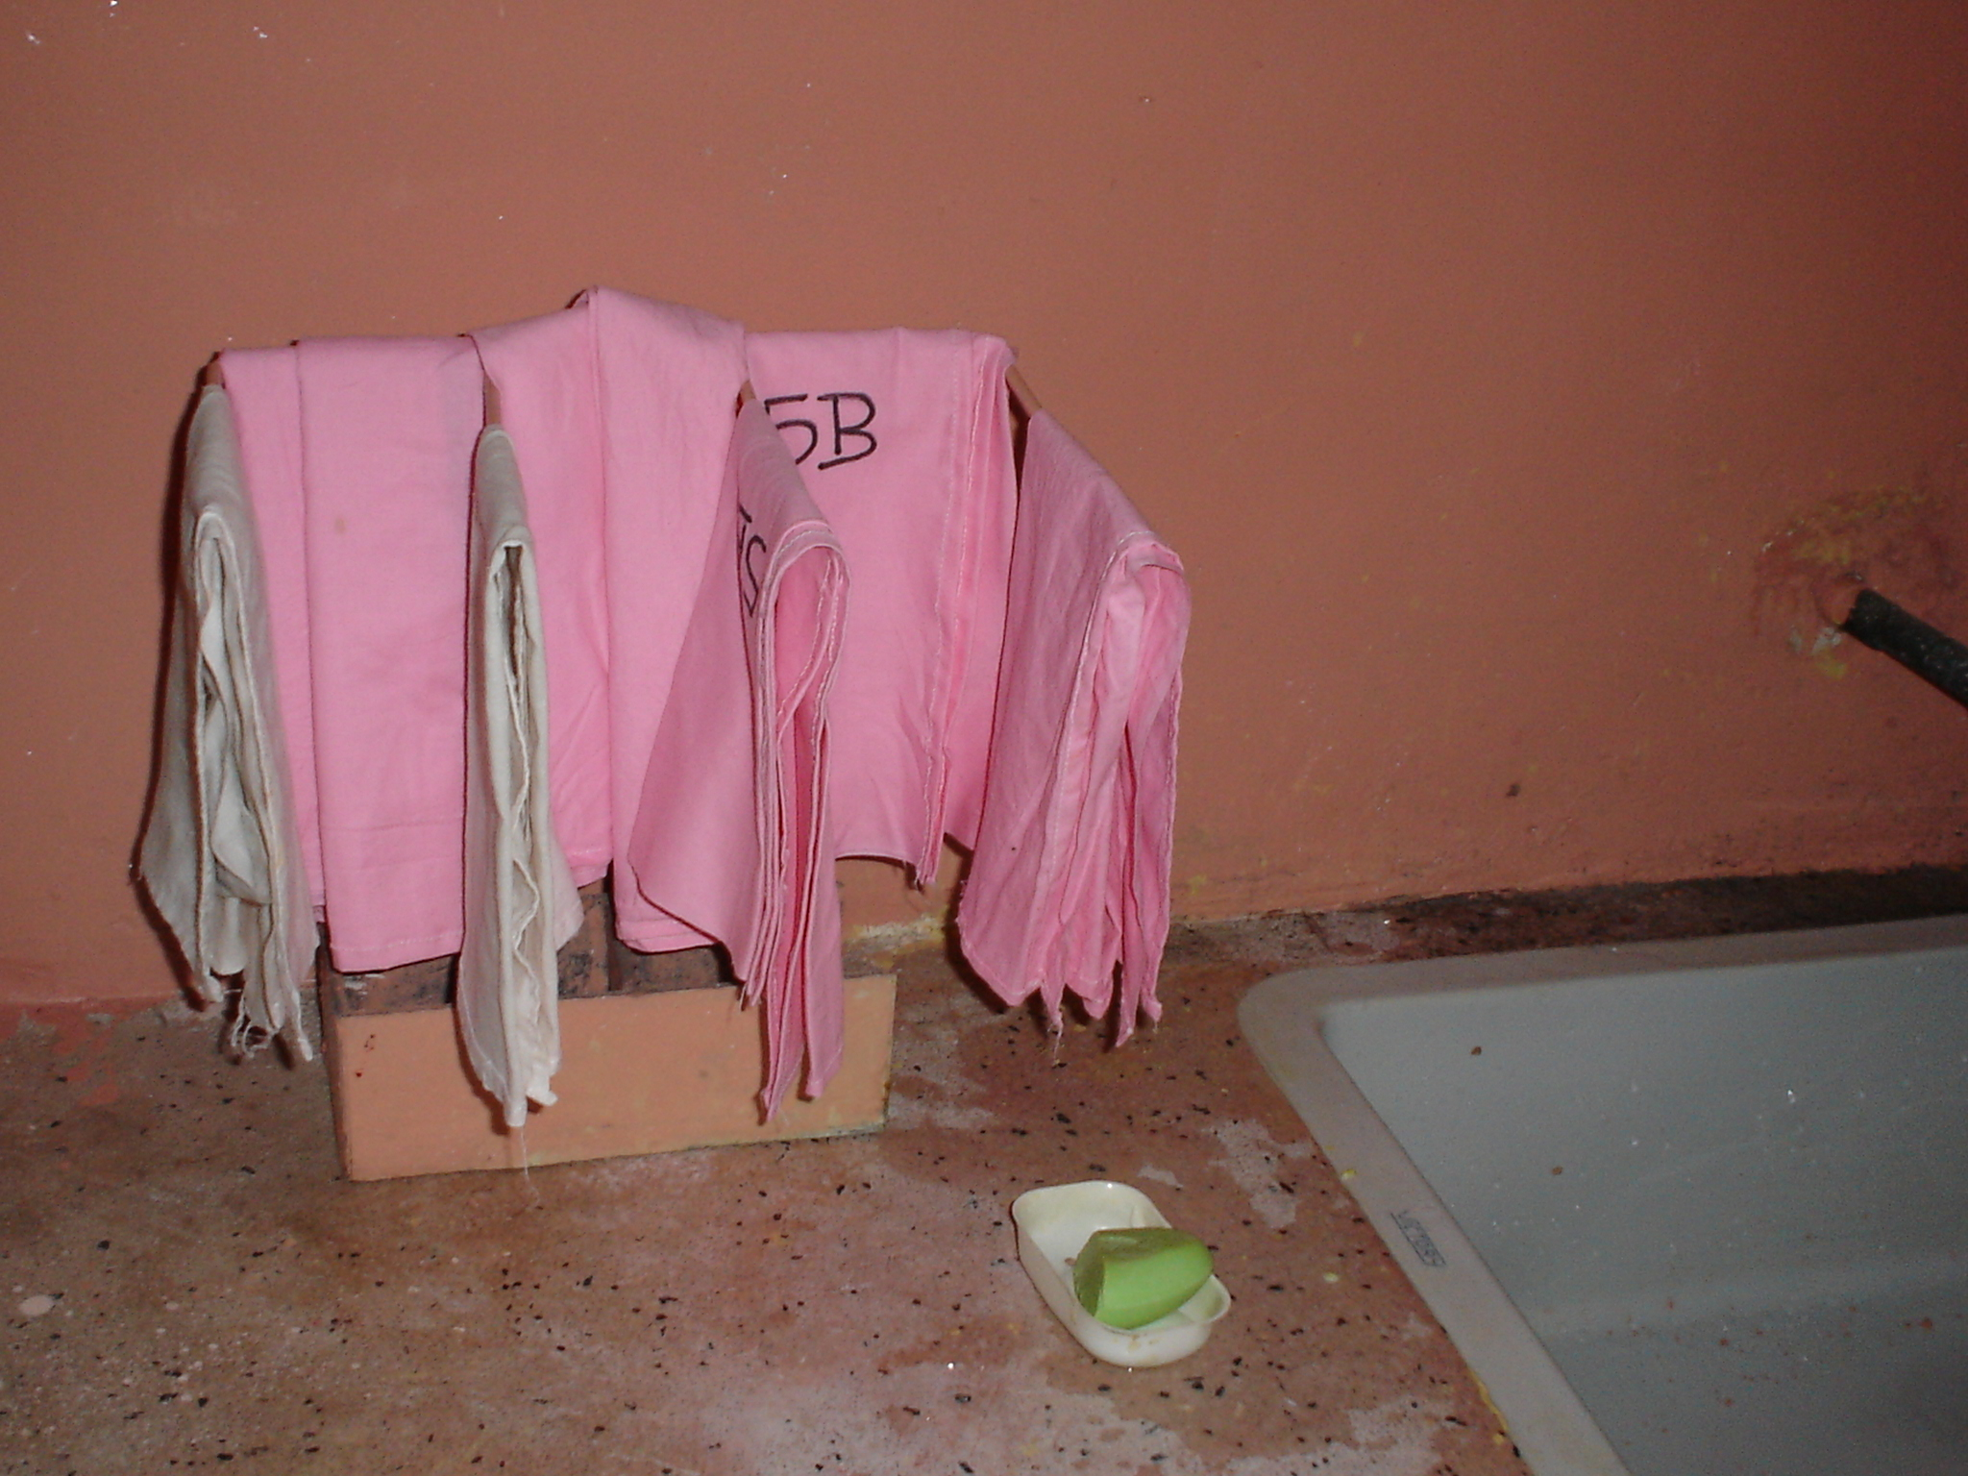

Slide 57
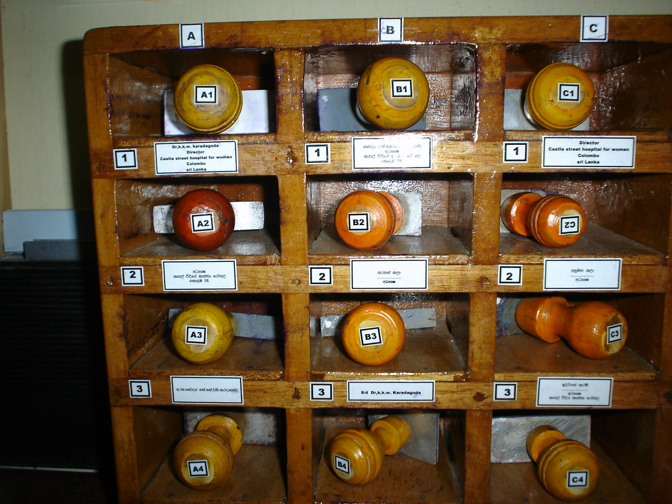

Slide 58
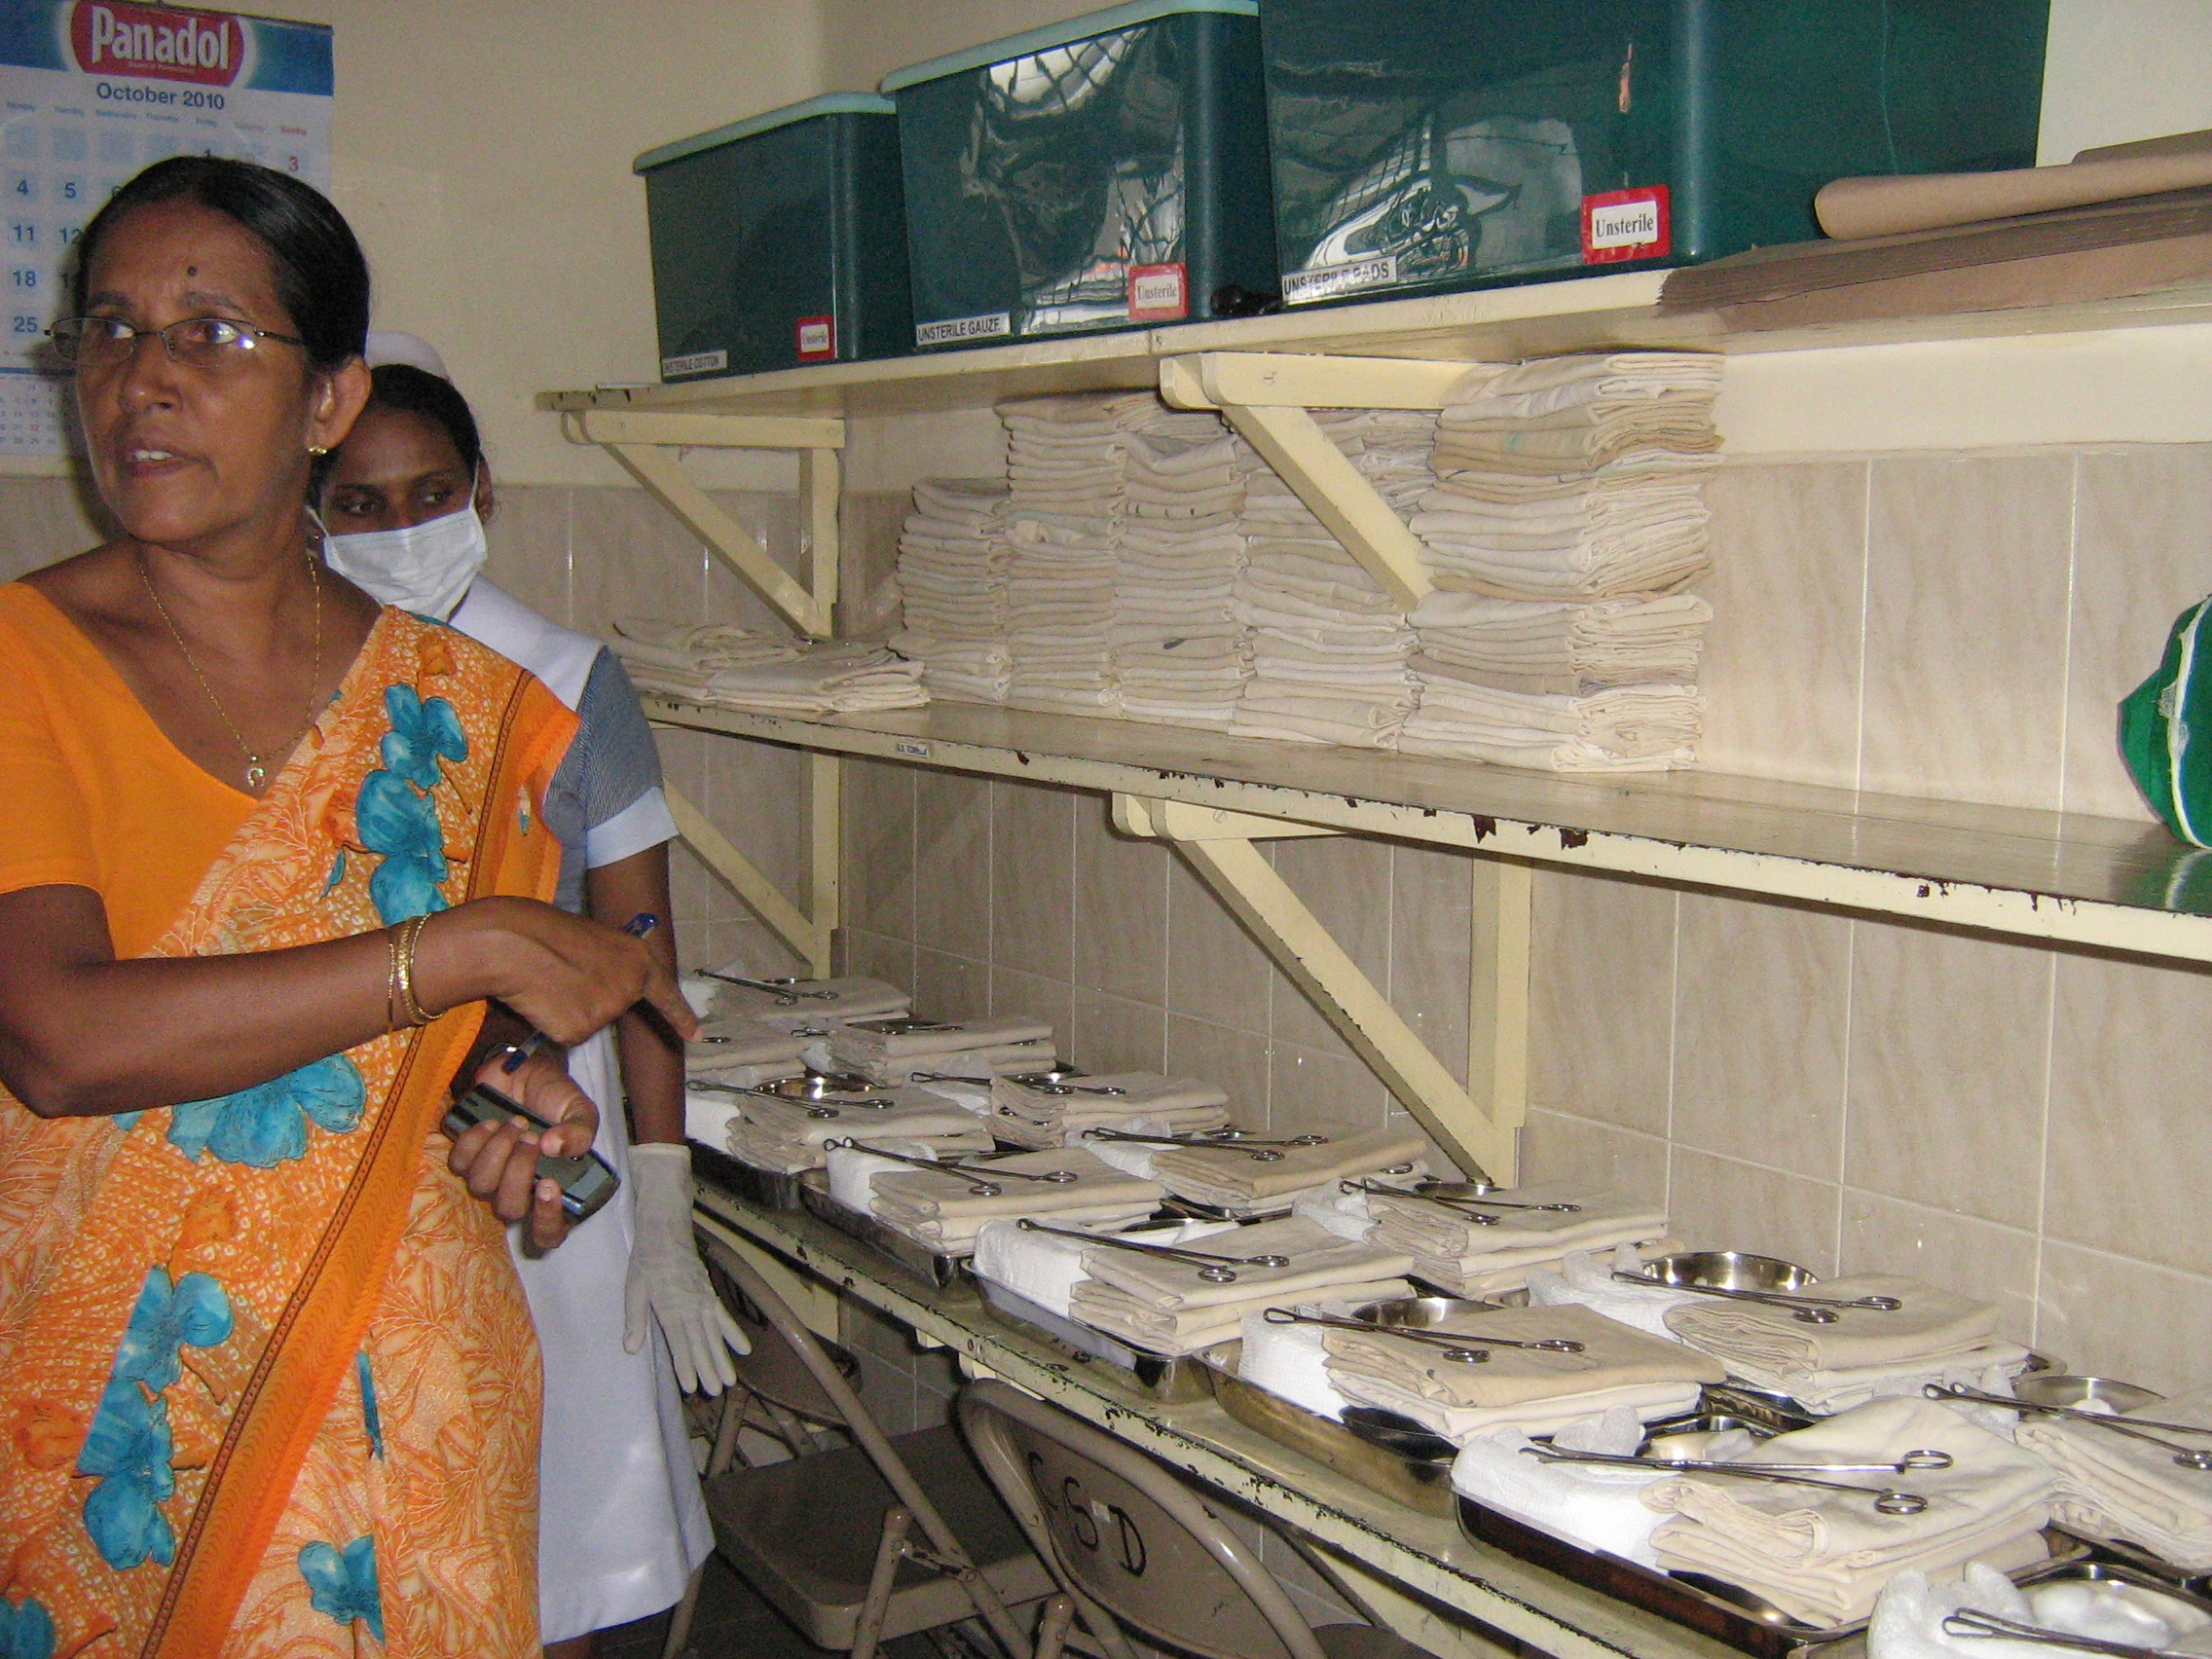

Slide 59
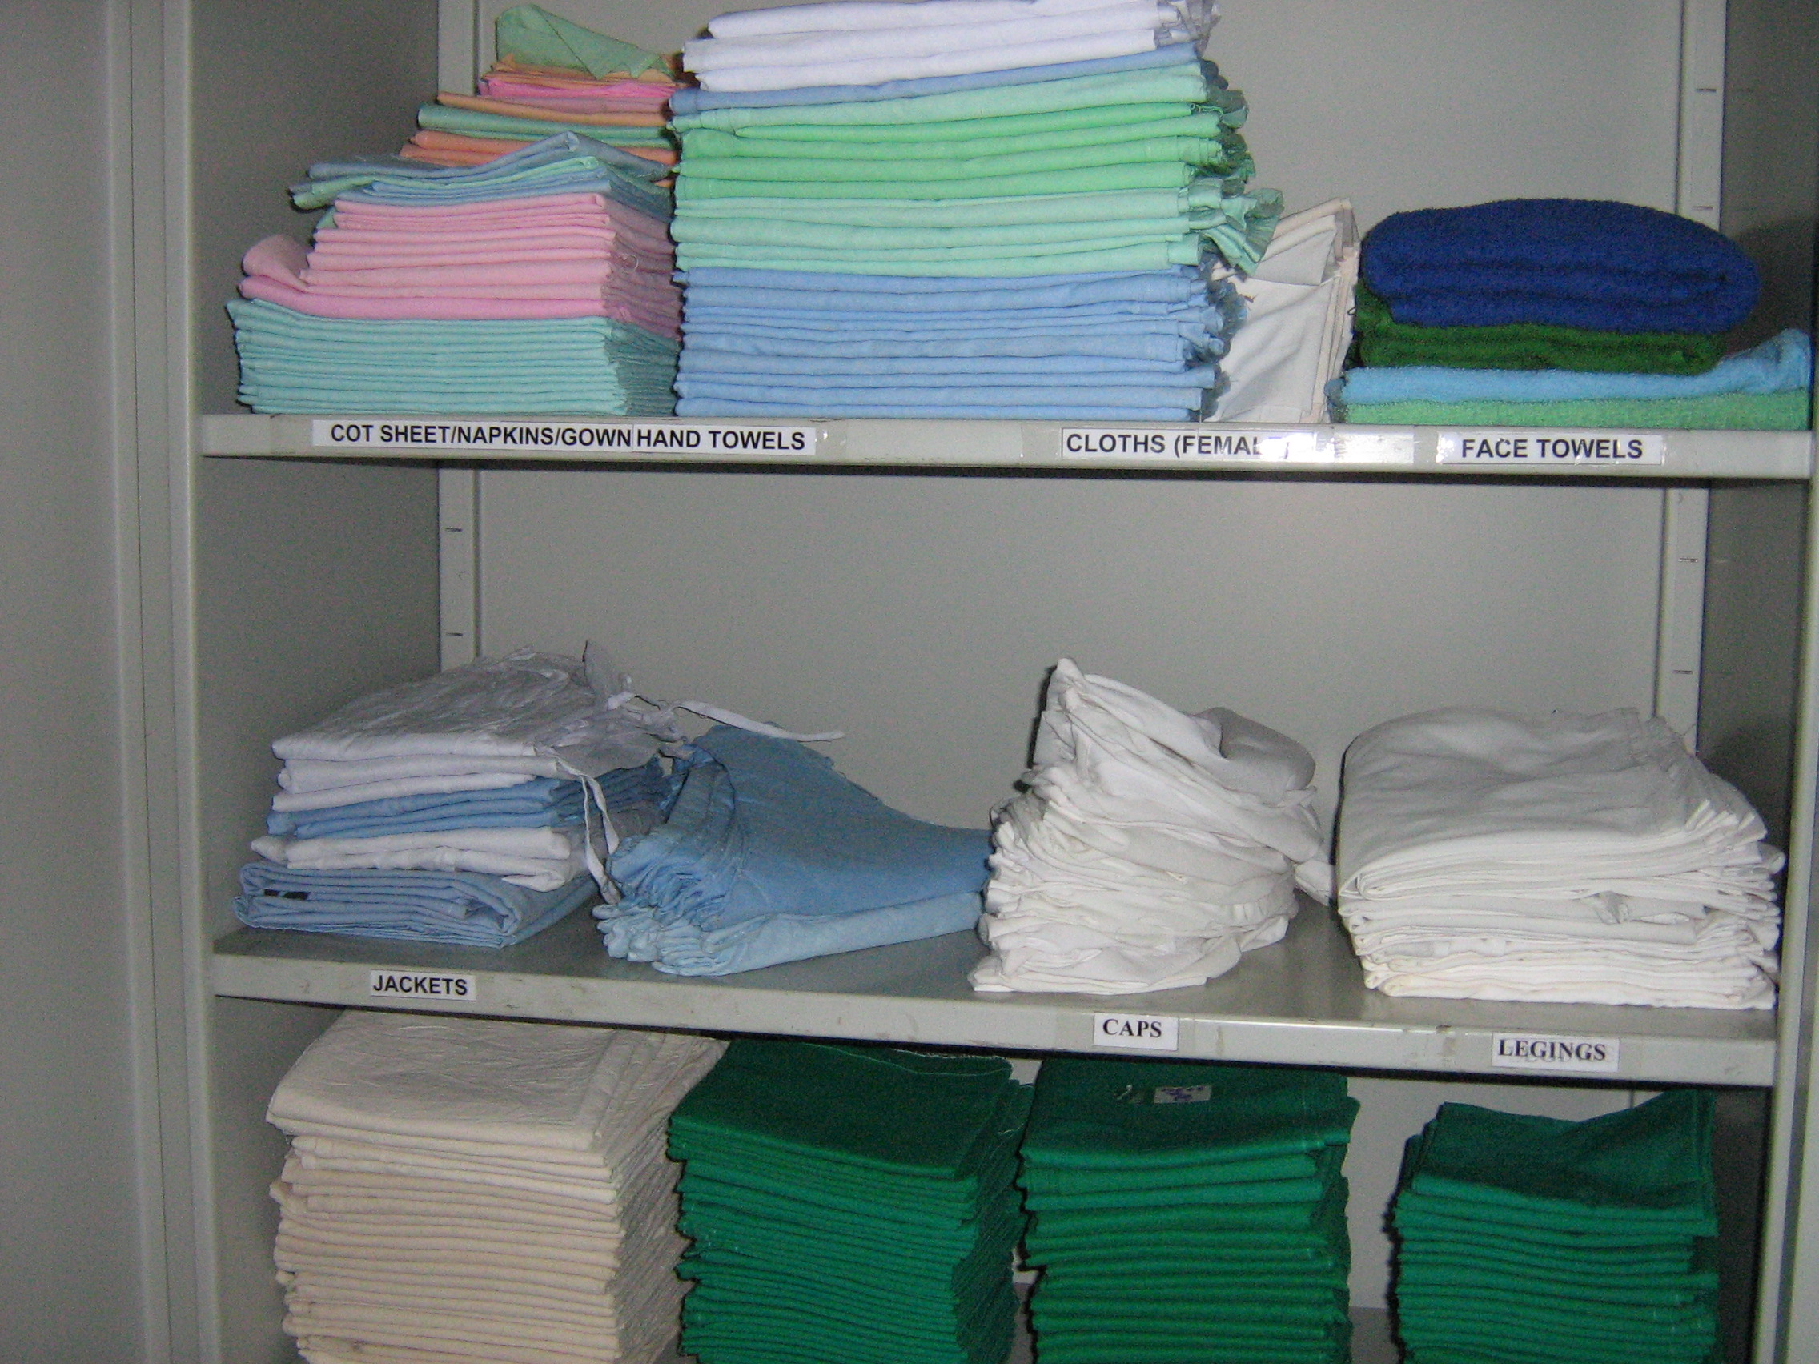

Slide 60
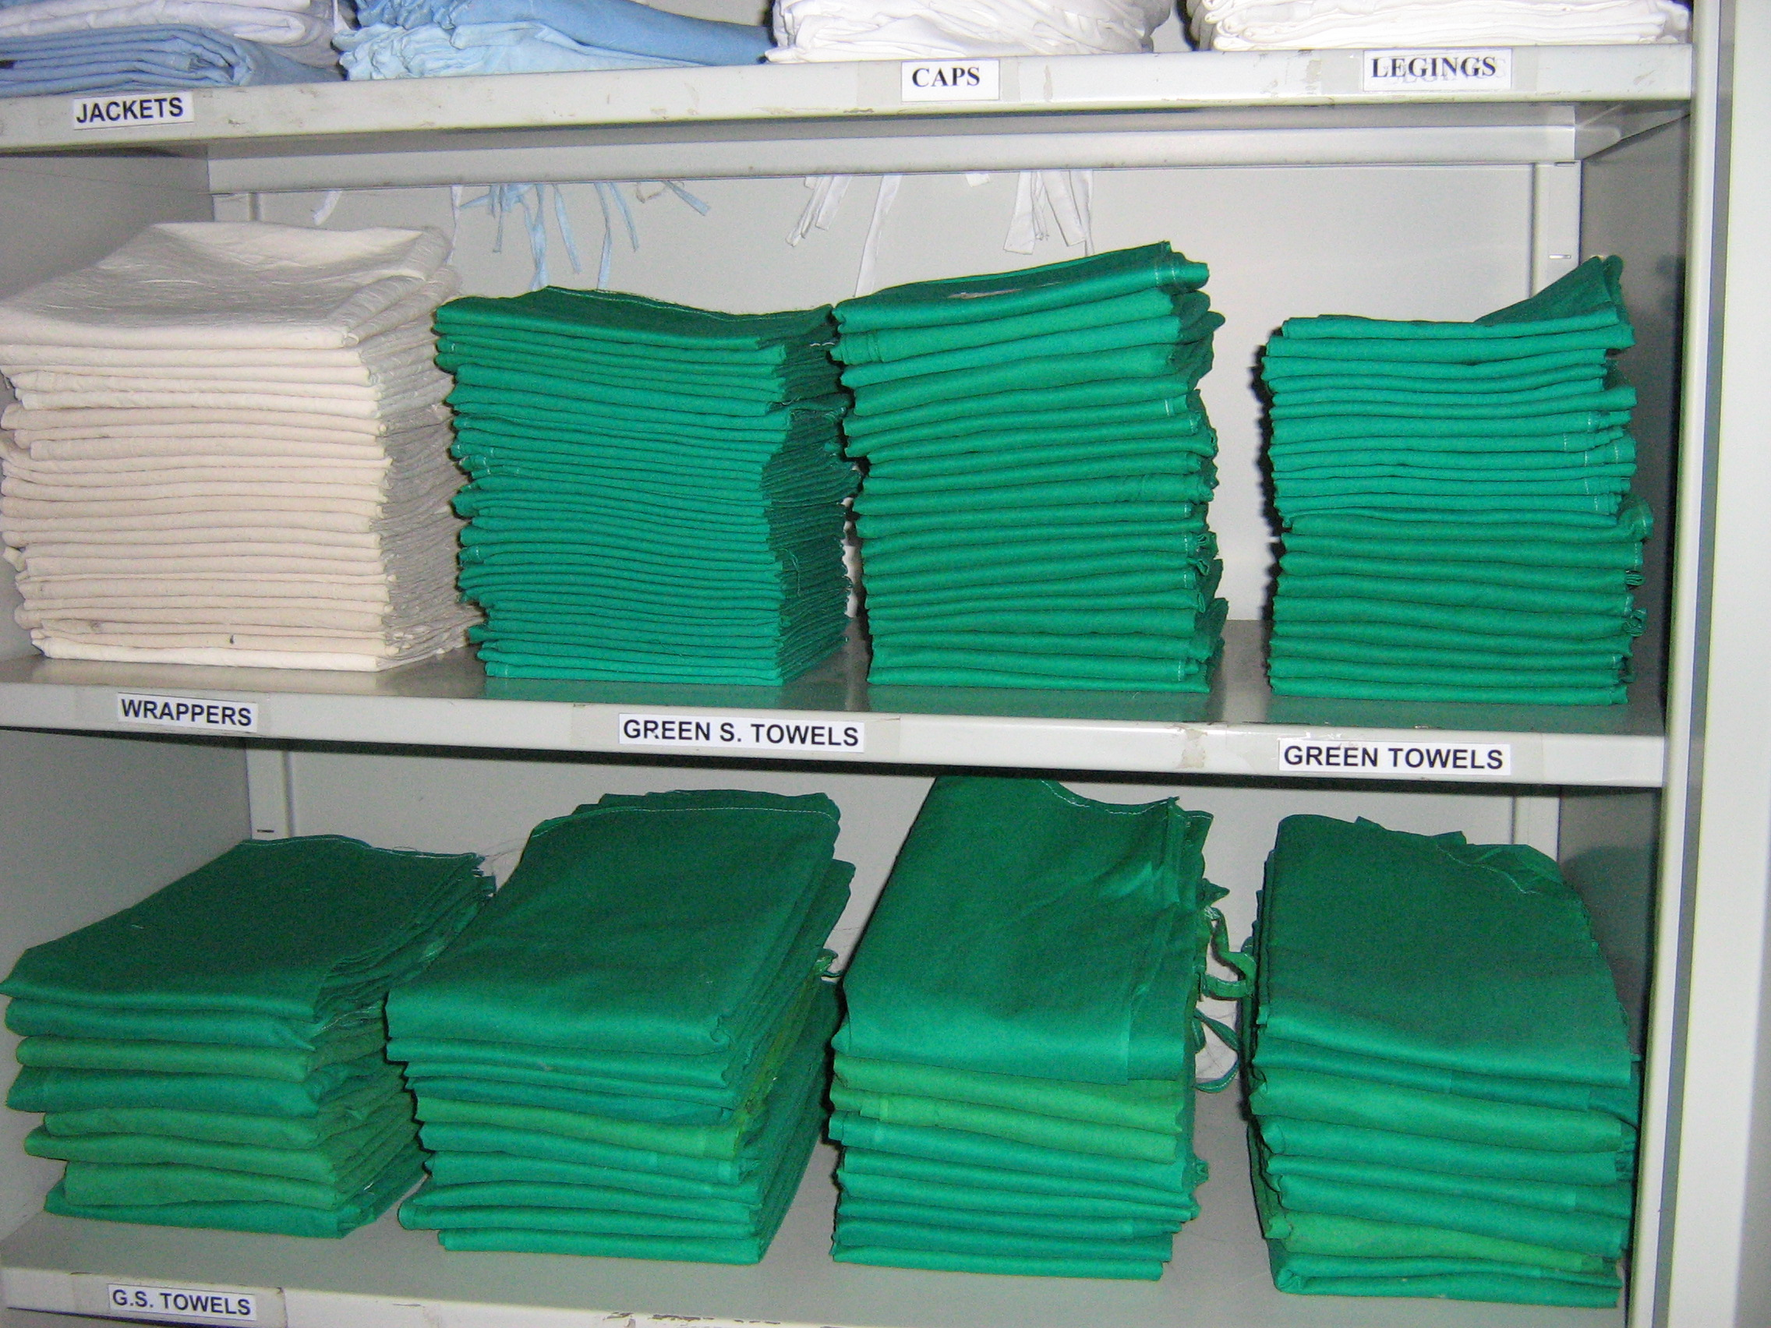

Slide 61
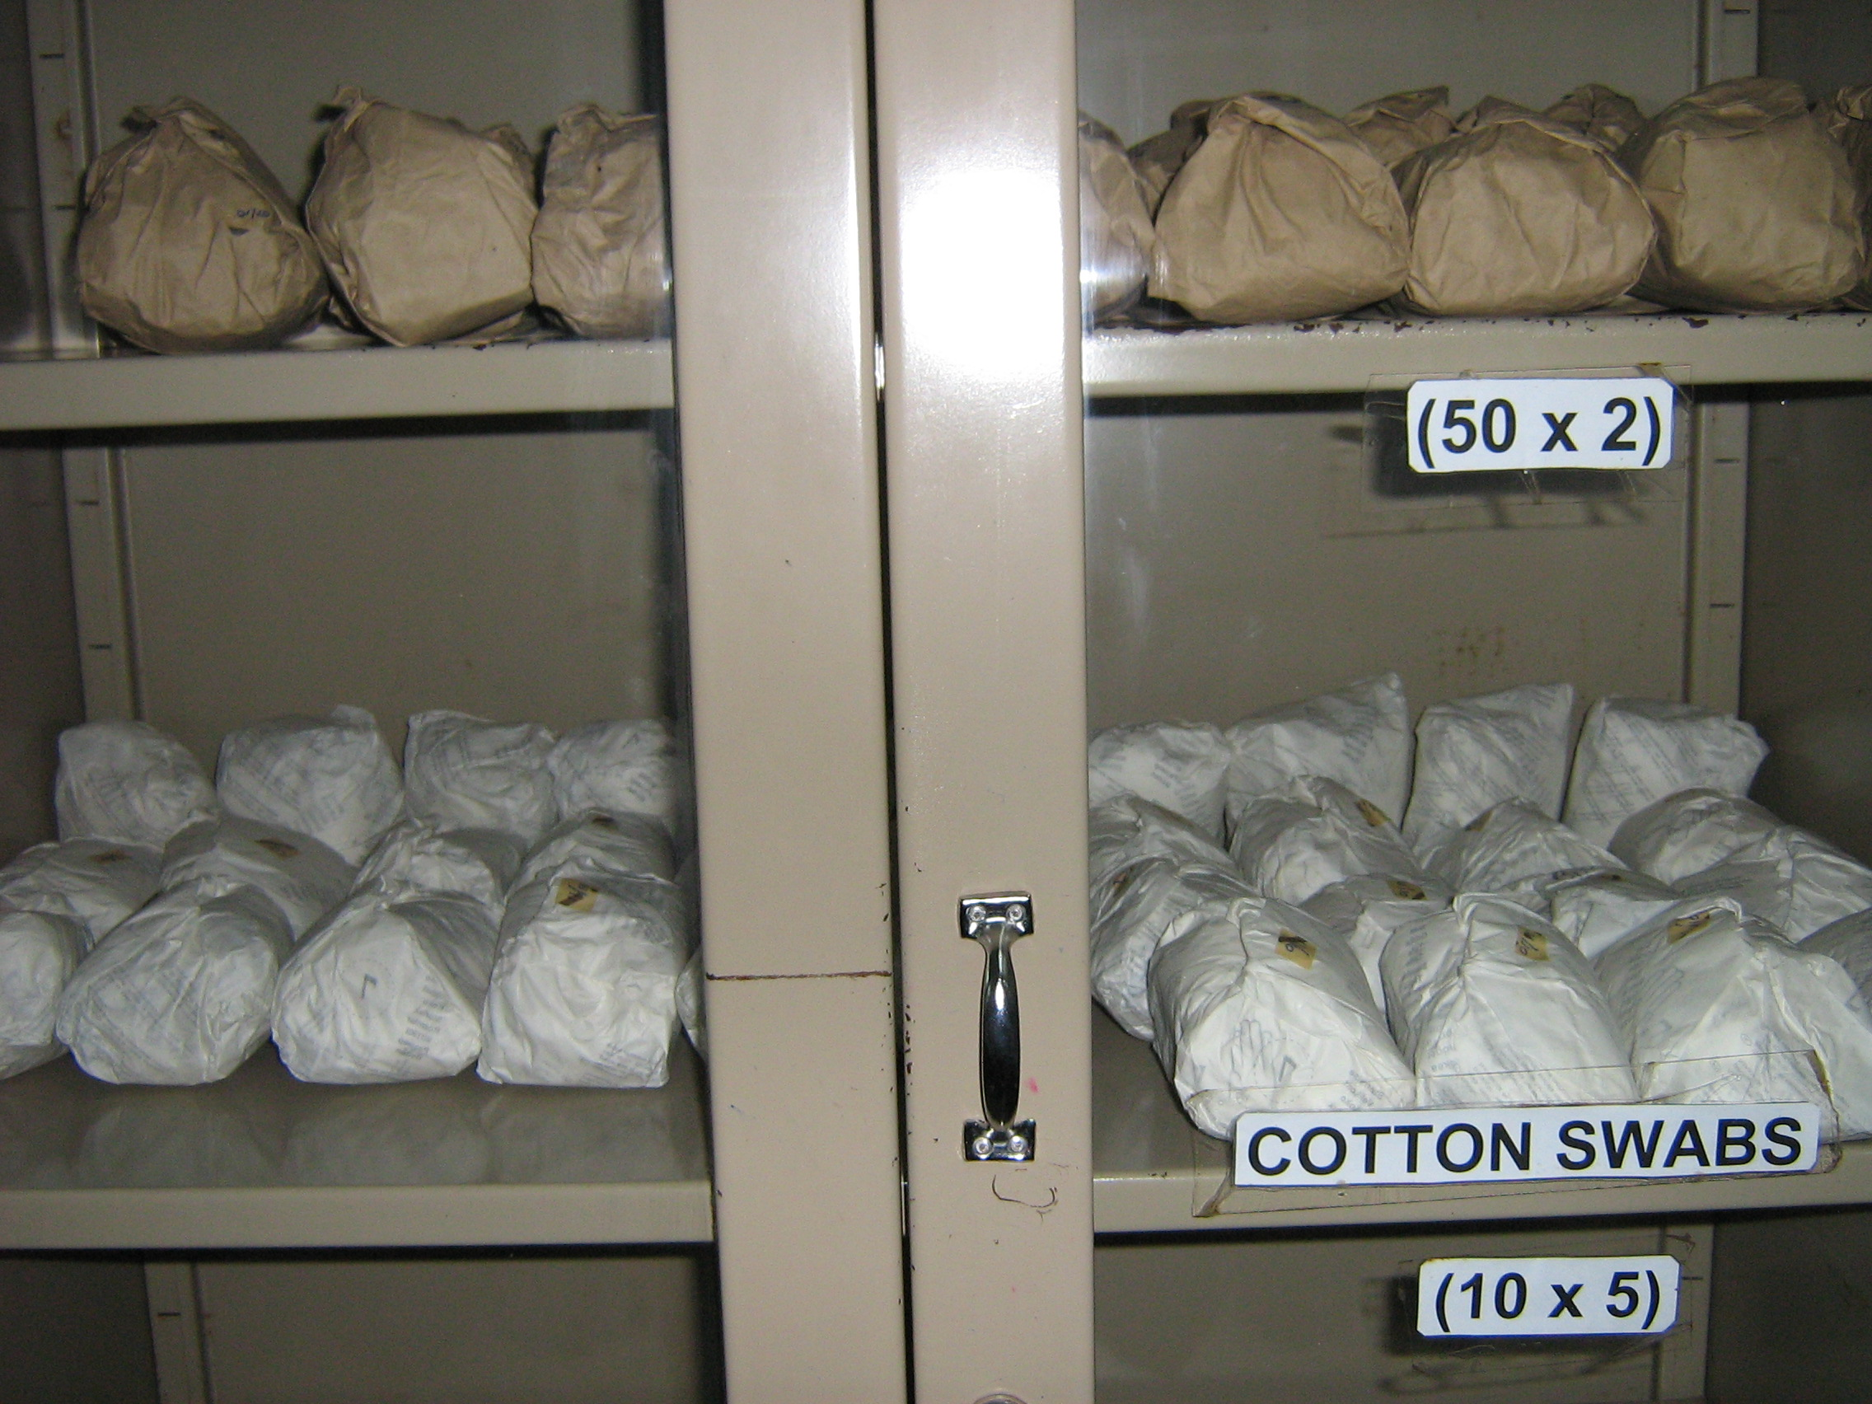

Slide 62
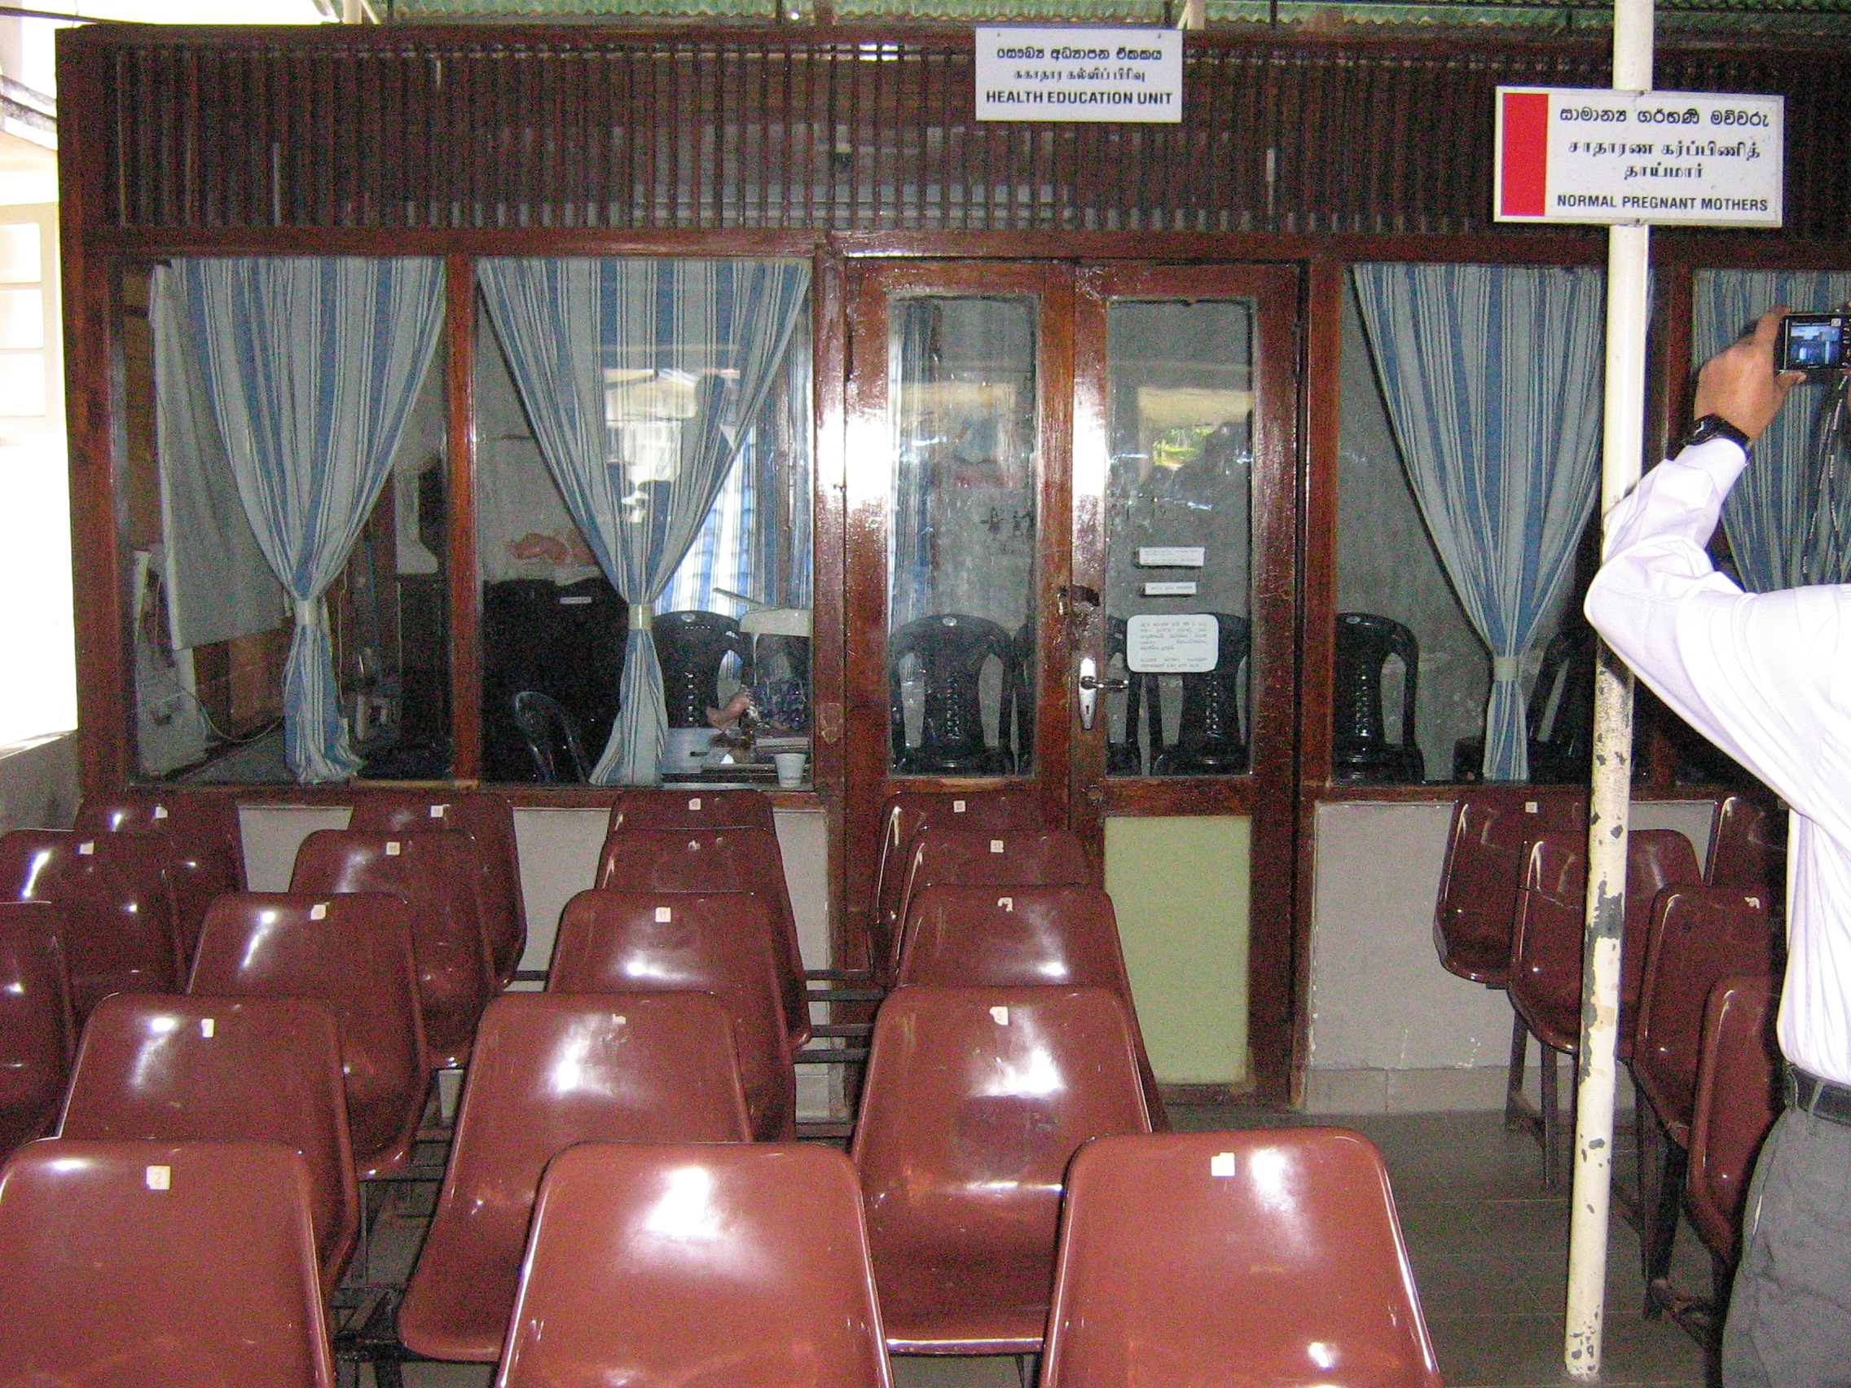

Slide 63
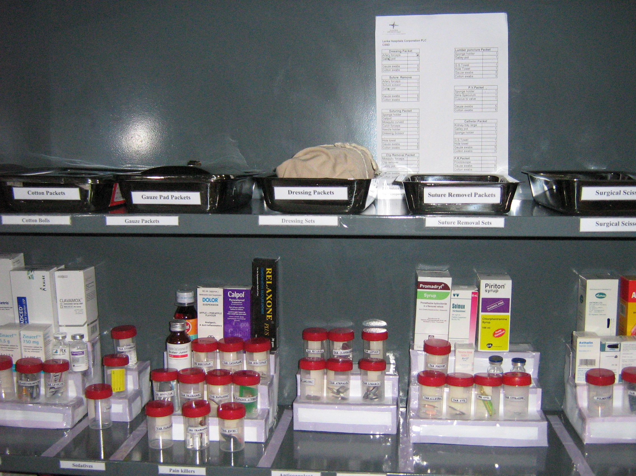

Slide 64


Slide 65


Slide 66

Shine (Seisou)
Keeping the toilet clean is also an important activity for Shine.

Slide 67
Bangladesh Experience
QIS has been supporting the DGHS to implement 5S/Kaizen/TQM in 12 district hospitals
Staff received orientation on 5S at all hospitals
WITs and QITs have been formed with development of action plan for implementation
The focus is on application of 5S
There are some changes in some of the areas, but much more needs to be done

Slide 68



Slide 69



Slide 70



Slide 71





Slide 72



Slide 73



Slide 74



Slide 75


Pre-packaging
March 2011

Slide 76


Store
After
Before

Slide 77


Store
After
Before

Slide 78




Store in-charge office
Before
After

Slide 79




Labor room Store
Before
After

Slide 80



Pharmacy
Before
Before
After

Slide 81



Pharmacy and Lab
Before
After

Slide 82




Before
After

Slide 83
Before
After

Slide 85



Slide 86




Changes in Jhenaidah Sadar Hospital

Slide 87




Changes in EOC Ward
Before
After
Before
After
Before
After

Slide 88








Changes in Surgery Ward

Slide 89




Changes in Padietric & Medicine Ward
Before
After
Before
After

Slide 90




Changes in Gardens of The Hospital
Before
After
Before
After

Slide 91




West Management & Campus Protection
Before
After
Before
After

Slide 92




Changes in office and hospital internal environment
Before
After
Before
After

Slide 93




Improved pediatric word by local initiative

Slide 94


